Slide 1
Data for all
Empowering teams with scalable Shiny applications

Slide 2
Data culture
In many organisations, data scientists find themselves responsible for introducing a data culture in an environment where data was not used historically
One strategy for doing so involves making data accessible to teams across the organisation in a way that is easy to understand and use
Internal dashboards are a great way of exposing data to teams at the right level – not too raw, but not so summarised as to be unactionable
Our tool of choice for building internal dashboards is Shiny

Slide 3
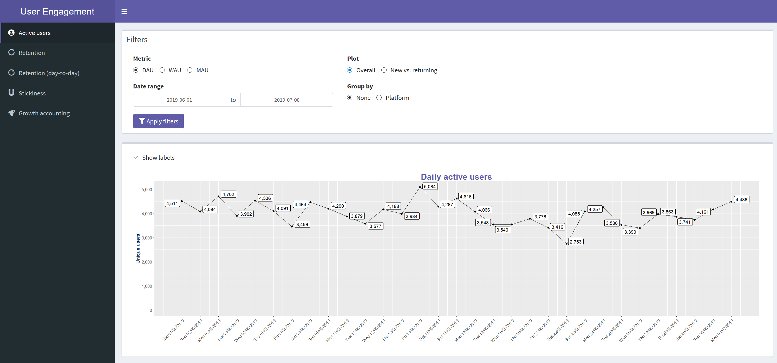

Slide 4
No-ETL
No ETL required – queries run directly against the analytics database
Pro: data scientists work independently of engineers as they can simply code any extra complexity (e.g. cohorting) into the dashboard directly
Con: there's potential for long-running queries that would lock up the dashboard for other users

Slide 5
Shiny tech challenges
How do we:
Allow for potentially long-running reactive() expressions
Support 10s or 100s of concurrent users
Package all this up for cloud deployment via a DevOps pipeline
Integrate with an existing user account system (e.g. Exchange)

Slide 6
Asynchronicity and concurrency
How we use futures and promises to support long-running queries and many concurrent users

Slide 7
Promises
R is traditionally single-threaded
This restriction is inherited by Shiny
Whilst we wait for a DB query to return, our dashboard stalls for other users
Enter promises and futures!
Promises represent a value that will be ready later
We can do other work whilst waiting
In a dashboard context, we use promises to represent DB queries that retrieve a data frame, and are started with the "Apply filters" button

Slide 8
Futures
Promises alone don’t fix our problem
They represent the “promise” of an eventual value but don’t give us any way to actually do work elsewhere to retrieve it
Futures are a concrete method of fulfilling promises by executing code in a separate R interpreter instance
They meet the spec for promises, so we can use them like so:
future({ slow_db_query() }) %...>% print()

Slide 9
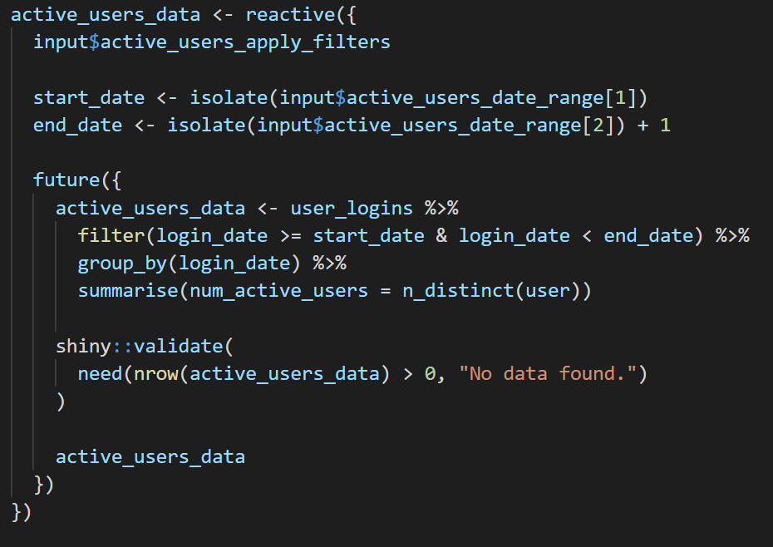
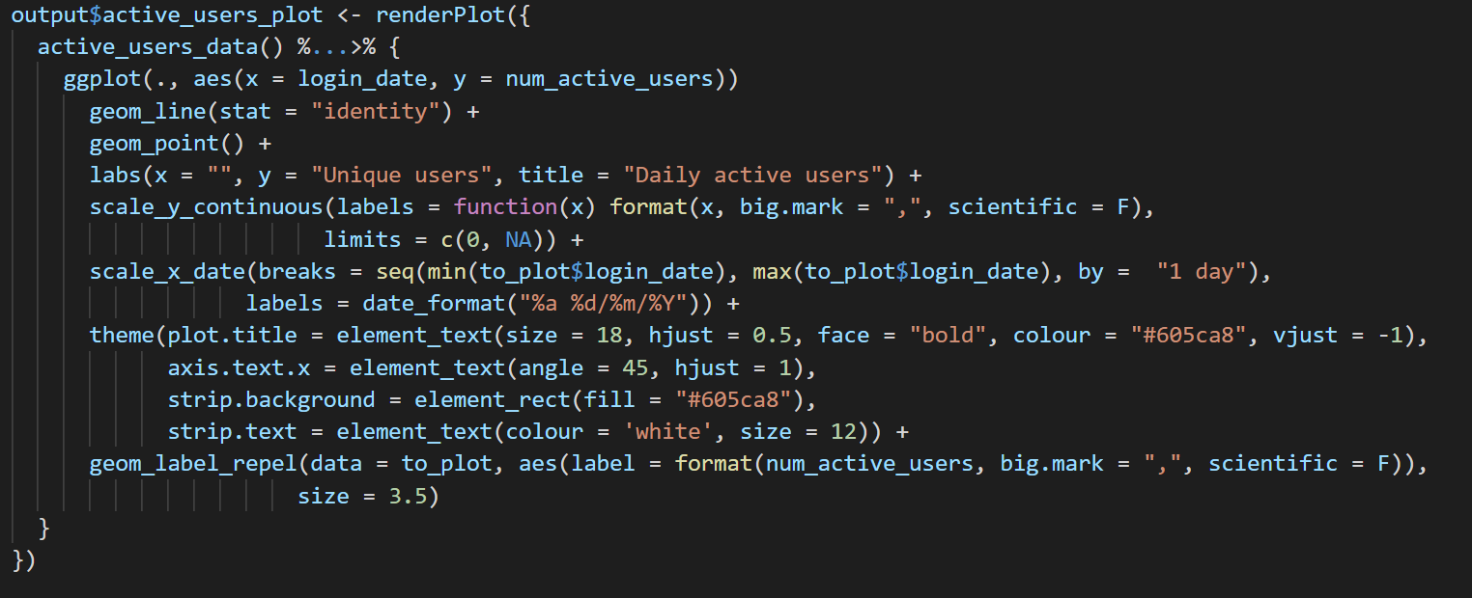
Futures and promises in Shiny
Support has been rolling out into the ecosystem over the last few years
Fully supported by reactive expressions and render functions

Slide 10
Packaging with Docker and Packrat
How do we take our source code plus dependencies and package it all up into a single standalone container?

Slide 11
Packrat
Solves the problem of managing package dependencies for an R project
Maintains a manifest file, packrat.lock, describing exactly which versions of what packages your project needs
Saves your colleagues from the inevitable hell of coordinating package upgrades
Just updated to latest from your dashboard repo?
Simply run packrat::restore()

Slide 12
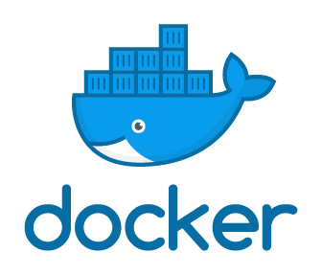
Docker
Allows us to package an application up with all of its system-level dependencies, even the OS
You write a Dockerfile, which describes how to build the service
These containers can then be downloaded and run via several different methods:
Standalone, with docker run $your_container_name
On an orchestration platform, like Kubernetes or ECS
More on this later!

Slide 13
Docker – pseudo-Dockerfile steps
Use Ubuntu 18 as a base
Install R and packrat
Copy our packrat.lock into the container, and run packrat::install()
Copy the rest of our dashboard source code
Record that we’re exposing port 3838 for incoming connections

Slide 14
Deploying to the cloud
With our dashboard packaged up, how do we get it deployed somewhere? What other services can we make use of to solve some of our problems?

Slide 15
Amazon Web Services
Most popular cloud provider
Basic services like Elastic Compute Cloud (EC2), for manually provisioning VMs
Sometimes useful, but we want a little less work to do
Value-add services like Elastic Container Service (ECS)

Slide 16
Elastic Container Service (ECS)
Allows us to orchestrate the deployment of applications we’ve bundled up into Docker containers
First, we push our dashboard container image to Amazon’s private container registry
Then we can represent each dashboard as a service in ECS
Upgrades are simple: just update the service definition with the latest container ID, and ECS will roll out the change for you

Slide 17
Scaling on ECS
A single service is fine, but do we handle situations where we have more users than one instance can handle?
A service can have a configurable number of tasks
For static use cases, you can just set a number of tasks to run
For complex or variable situations, you can auto-scale your task count based on metrics like current CPU usage
This gives us additional ability to handle traffic beyond even what the aforementioned futures and promises give us

Slide 18
Network infrastructure
Services can integrate with an Application Load Balancer (ALB) that's tied to a domain, like some-dashboard.my-company.com
Now, users can simply navigate to that address and browse the dashboard!
To lock this down to just our authenticated users, we utilise another service called Cognito that integrates with our user account database and handles the sign-in process for us

Slide 19
Users
User loads https://dashboard.my-company.com in a browser
Application Load Balancer
ALB passes the request to Cognito
Account DB
Cognito
If the user is already authenticated, forward the request to Shiny!
Otherwise, prompt the user to sign in
Dashboard service in ECS
Data Warehouse
Dashboard task 1
Dashboard task 2
Dashboard task N...

Slide 20
The data science workflow

Slide 21
Dashboard workflow goals
No data engineers required for day-to-day work
Minimal latency when publishing new analyses and views
Code review in GitHub for all non-trivial changes

Slide 22
Continuous deployment
Just responsible for building and pushing our Docker images
Tooling: TeamCity, Jenkins, CodePipeline, etc
Any commits merged into the master branch automatically trigger a build and redeploy
New content is made available to users in a matter of minutes

Slide 23
HypotheSci
Consultancy for data science and engineering
End-to-end data and dashboard pipelines that empower teams and help organisations leverage their data
Feel free to reach out :)
Ruan Pearce-Authers
Twitter: @returnString
Email: ruan@hypothesci.com
Alexandra Țurcan
Twitter: @AleTurcan
Email: alex@hypothesci.com

