Slide 1
The Power of Collaboration: ISC Working Groups
Joseph B. Rickert
useR!2019

Slide 2
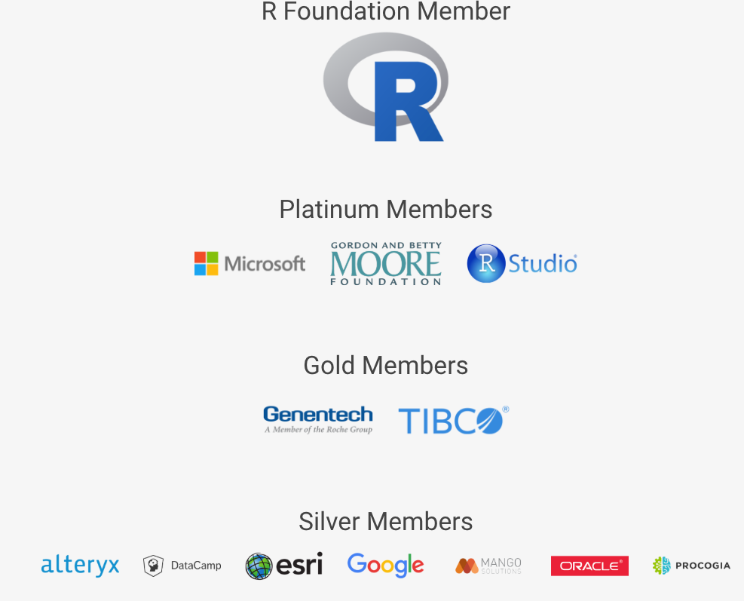
R Consortium Membership 2019

Slide 3
Goals and Activities
R Consortium Goals:
Promote the growth and development of R as a leading platform for data science
Support the R Foundation and the R Community
Help to foster the use of R enterprise scale environments
Foster collaboration between companies for the benefit of members and the R Community
Sponsor Events
Fund Projects
Nurture Working Groups

Slide 4
R Consortium Working Groups
A place to make things happen!
Teams for exploring new technology
Impartial forums for achieving consensus
A mechanism for organizing and executing large collaborative projects

Slide 5
Benefits of R Consortium Working Groups
Sponsored by the ISC, a nonpartisan organization dedicated to fair, open and transparent work
Receive administrative support from the R Consortium
Visible to the greater R Community
Open to all R Community members not just employees from R consortium member companies

Slide 6
R Consortium Working Groups
Census Working Group: Is developing package recommendations, and other materials for working with census data.
Code Coverage: Helping to improve R software quality through the development of a code coverage tool and promoting the use of code coverage more systematically within the R ecosystem.
Future-proof native APIs for R: Is working to assess current native API usage, gather community input, and work towards an easy-to-understand, consistent and verifiable API that will drive R language adoption.
histoRicalg: This project aims to document and test older Fortran and C and other code that is still essential to the R ecosystem, possibly creating all-R reference codes, hopefully by teaming older and younger workers so knowledge can be shared for the future.
R Certification: Is working to establish a common certification program for proficiency in R.
R Community Diversity and Inclusion Working Group: A group broadly consider how the R Consortium can best encourage and support diverse and inclusion in the R Community
R / Medicine: R users in the medical industry collaborating on events and advocacy of R.
R / Pharma: R users in the pharmaceutical industry collaborating on events and advocacy of R.
R Validation Hub: Working to devise a standard for validating packages for the regulated Pharmaceutical industry and create a online repository that will be free to use.
Unified Framework for Distributed Computing in R: Now inactive, explored the feasibility developing a common framework to standardize the programming of distributed applications in R.

Slide 7
R Validation Hub is a cross-industry initiative whose mission is to enable the use of R by the Bio-Pharmaceutical Industry in a regulatory setting, where the output may be used in submissions to regulatory agencies.
R Validation Hub Goals:
Validate R Packages
Platform for sharing tests
Relevant QA information
Free to use
https://www.pharmar.org/
Notes:
R Validation Hub Goals:
Validate and Standardize R Packages
Be a platform for sharing tests
Provide links to relevant QA information
Be free to use

Slide 8
R Validation Hub Membership
Abbvie - Greg Cicconetti
Amgen - Bella Feng, Min Lee
Astellas - Michael Carniello
Bayer - Karl Brand
Biogen - Dan Boisvert, Bob Engle, Eric Milliman, Nate Mockler
BioMarin Pharmaceutical Inc. - Dharmesh Desai
Boehringer-Ingelheim - Matthias Trampisch
Cognigen Corporation - Nash Delcamp
Eli Lilly - Eric Nantz
FDA - Tomas Drgon, Paul Schuette, Mat Soukup
Galapagos NV - Paul Meyvisch
Genentech - Doug Kelkhoff
GSK - Tilo Blenk, Andy Nicholls, Alexander Lock-Achilleos
IQVIA - Thomas Brechenmacher, Jack Elkes
InModelia - Patrice Kiener
Johnson & Johnson - Paulo Bargo, Mark Bynens, Satish Murthy, Karma Tarap
Merck KGaA/EMD Serono - Martin Gregory, Juliane Manitz
MSD - Keaven Anderson, Rinki Jajoo, Edward Lauzier, Yilong Zhang
MRC-BSU - Kevin Kunzmann
Novartis - Xiao Ni, Huilei Xu
Novonordisk - Claus Dethlefsen
Pfizer - John Sims
Phastar - Lyn Taylor
PPD - Craig McIlloney
Quanticate - Niccolo Bassani
RCPE - Phillip Clarke
Rho, Inc. - Rebecca Krouse, Steve Noga
Roche - Alun Bedding, James Black, Markus Elze, Jules Hernandez-sanchez, Reinhold Koch, Kieran Martin
RStudio - Phil Bowsher, Joseph Rickert
Sanofi - Patric Stracke
Scharp - Anthony Williams
Servier - Mickael Guedj, Yann Robert
SQN Clinical - Chris Toffis
Promoting Statistical Insight
European Federation of Statistics in the Pharmaceutical Industry
Application and Implementation of Methodologies in Statistics (AIMS) SIG

Slide 9
Software ‘validation’: Draft Workflow
Internal Validation
Does the software come from a trusted source?
Risk Score?
Requirement for new statistical software
Perform risk assessment
Write detailed Requirements
No
High
Low
Yes
SAS
R Foundation
RStudio
Qualify software in our environment
Write test cases (unit tests)
“Trusted source” – We are confident in the organisation’s internal validation process
IQ, OQ, PQ – typically involves execution of existing tests

Slide 10
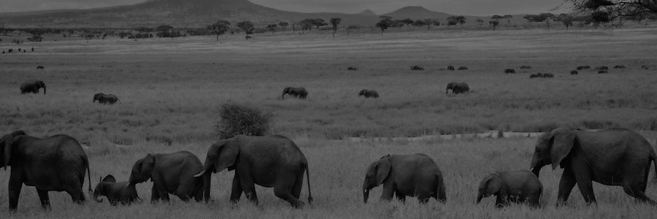
R Community Diversity and Inclusion (RCDI-WG)
Members
Ahmadou
Stefanie Butland
Jennifer Bryan
Scott Chamberlain
Adnan Fiaz
Jeffrey Hollister
Dennis Iorere
Shelmith Kariuki
Derrick Kearney
Curtis Kephart
Angela Li
Stephanie Locke
Kaelen Medeiros
Thomas Mock
Kevin O'Brien
Gabriela de Queiroz
Joseph Rickert
Sina Rüeger
Just Shea
Noa Tamir
Samantha Toet
Vebashini
Sydeaka Watson
Hadley Wickham
Kara Woo
Goal: to broadly consider how the R Consortium can best encourage and support diverse and inclusion
Short-term: define and publicize best practices for R community events
Long term: weave throughout all R consortium activities
Github: https://bit.ly/2WSrltF

Slide 11
Census WG
Goals:
Understand the data published by the Census Bureau
Understand the relevant R packages
Train R users in using Census Data
Facilitate cooperation with Census
Members:
Alexandra Barker – US Census Bureau
Ari Lamstein – independent consultant
Logan T Powell US Census Bureau
Kyle Walker – Texas Christian University
Zach Whitman – US Census Bureau
Resources:
Guide to Census Data: https://bit.ly/2K8PqGn
Census Data in R: https://bit.ly/2WZXAXz
Mapping Census Data with Choroplethr: https://bit.ly/2Ka16Jg

Slide 12
Code Coverage Tool for R
Working Group Members
Shivank Agrawal, Oracle
Chris Campbell, Mango Solutions
Santosh Chaudhari, Oracle
Karl Forner, Quartz Bio
Jim Hester, RStudio
Mark Hornick, Oracle – Group Leader
Chen Liang, Oracle
Willem Ligtenberg, Open Analytics
Andy Nicholls, Mango Solutions
Vlad Sharanhovich, Oracle
Tobias Verbeke, Open Analytics
Qin Wang, Oracle
Hadley Wickham, RStudio – ISC Sponsor
Continue developing a tool for R that determines code coverage upon execution of a test suite.
Promote the use of code coverage more systematically within the R ecosystem.
Work towards incorporating code coverage testing and reporting into CRAN processes.
Continue to assess enhancements to the covr package.
For more informatiion see:
Blog post: https://bit.ly/2trR6CL
Project site:
https://wiki.r-consortium.org/view/Code_Coverage_Tool_for_R

Slide 13
histoRicalg WG
Goal: to preserve and transfer knowledge of older algorithms
WG Members
Árpád Lukács
Avraham Adler
Chris Park
Daniel Barnett
John Nash
Keith O’Hara
Oliver Dechant
https://gitlab.com/nashjc/histoRicalg

Slide 14
histoRicalg WG Activities
Work near completion
Establishing the provenance of
R's optim::BFGS, optim::CG and related minimizers
R code for root-finding of functions in one parameter
Talks:
Arpad Lukacs – “preserving Numerical Algorithms” at FOSDEM 19 Brussels
Video: https://video.fosdem.org/2019/K.4.601/retro_preserving_algorithms.mp4
Slides: https://gitlab.com/nashjc/histoRicalg/blob/master/media/Presike.pdf
Related Work:
John Nash is working with:
Matthew Fidler to merge the CRAN packages lbfgsb3 and lbfgsb3c which both use Fortran code
NASA contractor Sidey Timmons to provide the quadruple precision needed in modeling the magnetic field of Jupiter in John’s 1974 one-sided SVD code

Slide 15
www.rinpharma.com
Organizing Committee:
Elena Rantou - FDA
Melvin Munsaka - AbbVie
Eric Nantz - Eli Lilly
Paul Schuette - FDA
Michael Blanks - Beigene
Min Lee - Amgen
Reinhold Koch - Roche
Paulo Bargo - Janssen
Volha Tryputsen - Janssen
Elizabeth Hess- IQSS Harvard University
John Sims - Pfizer
Bella Fang Amgen
Michael Lawrence - Genentech

Slide 16
www.r-medicine.com
Organizing Committee:
Beth Atkinson - Mayo Clinic
Joseph Chou - Harvard University
Denise Esserman - Yale University (Program Chair)
Peter Higgins - The University of Michigan
Michael Kane - Yale University (Conference Chair)
Balasubramanian Narasimhan (Naras) - Stanford University
Joseph Rickert - RStudio
Hongyu Zhao - Yale University

Slide 17
Starting an R Consortium Working Group
Pick a project with wide scope that will:
Benefit a large portion of the R Community
Benefit from collaboration
Assemble a core team
Think about the finances:
If you do not need funding to start:
Write to the ISC to make your pitch: rconsortium-isc@lists.r-consortium.org
The ISC will vote go / no go
If you need funding to start:
Apply during one of the two annual proposal rounds

Slide 18
Make it happen!
Imagine on a grand scale.
Bigger than you can do alone
Bigger than your company can do on its own
Collaborate!

Slide 19
Thank You
R-consortium.org
David M Smith
Director, R Consortium
R Community Lead, Microsoft
davidsmi@microsoft.com
@revodavid
joseph.rickert@rstudio.com
@RStudioJoe

