Slide 1
‘Algorithmic Differentiation in R using the RcppEigenAD package’
by
Rob Crouchley, Dan Grose, Damon Berridge

Slide 2
Motivation
The primary advantage of AD is to eliminate the need to write code for derivatives, which means:
  Significantly less time needed to write code for your own research problem
  Less code means fewer code bugs
  Derivatives are provided to machine precision
  Out performs finite difference methods if dimensionality is large
In statistics AD enables easy application of:
  Optimization
  The delta method
  Implicit function theorem

Slide 3
What is RcppEigenAD?
RcppEigenAD
Multivariate Faà di Bruno, sourceCppAD, J, H
Rcpp
Marshalling of R data, sourceCpp
Eigen
Linear Algebra
CppAD
Algorithmic Differentiation

Slide 4
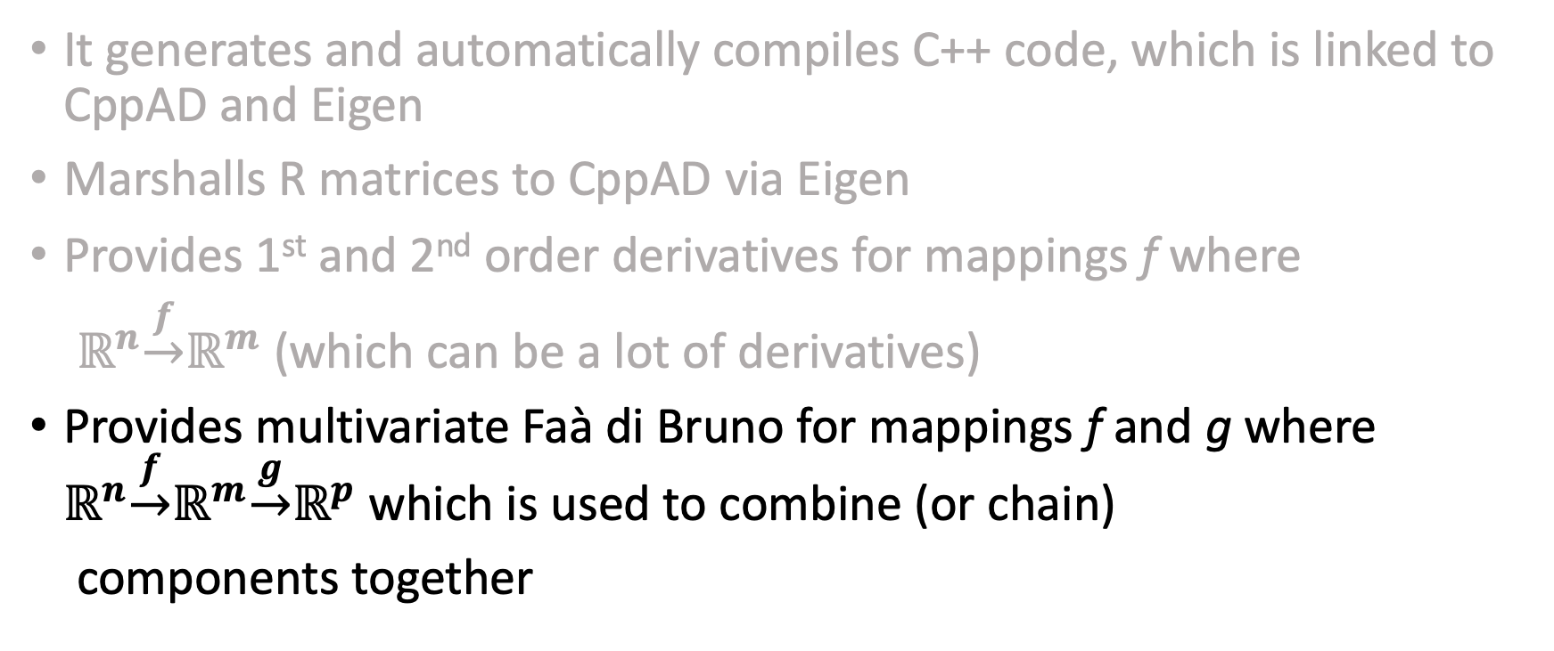
What does RcppEigenAD do?
It generates and automatically compiles C++ code, which is linked to CppAD and Eigen
Marshalls R matrices to CppAD via Eigen
Provides 1st and 2nd order derivatives for mappings f where
$ℝ^{n}\underset{→}{f}ℝ^{m}$ (which can be a lot of derivatives)
Provides multivariate Faà di Bruno for mappings f and g where $ℝ^{n}\underset{→}{f}ℝ^{m}\underset{→}{g}ℝ^{p}$ which is used to combine (or chain)
components together

Slide 5
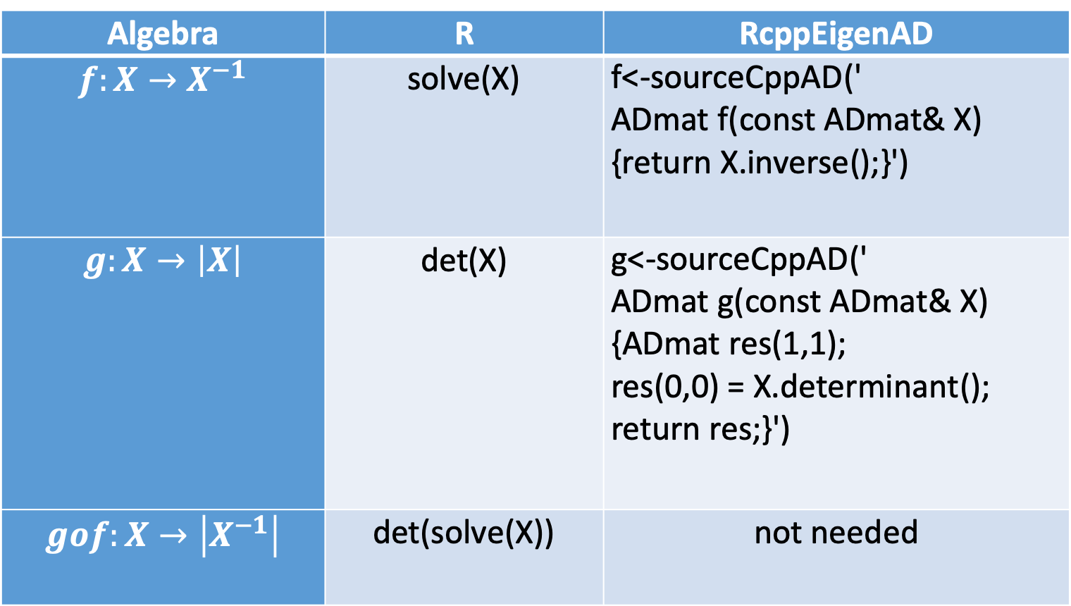
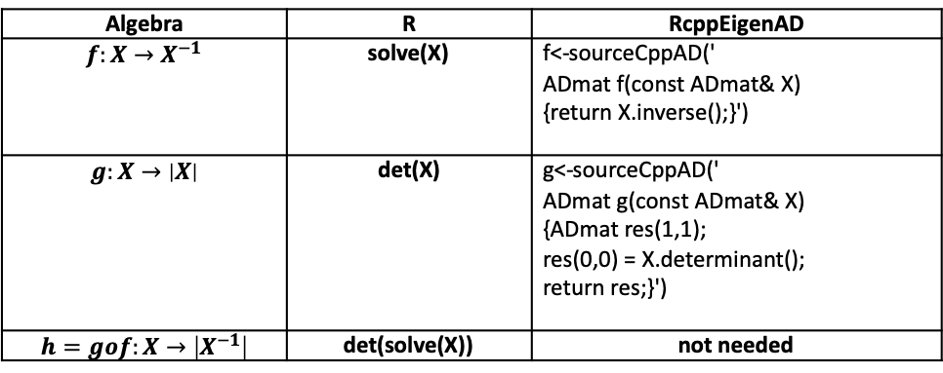
Simple Illustration of RcppEigenAD, part 1
Algebra | R | RcppEigenAD
$$f:X→X^{−1}$$ | solve(X) | f<-sourceCppAD(' ADmat f(const ADmat& X) {return X.inverse();}')
$$g:X→\left|X\right|$$ | det(X) | g<-sourceCppAD(' ADmat g(const ADmat& X) {ADmat res(1,1); res(0,0) = X.determinant(); return res;}')
$$gof:X→\left|X^{−1}\right|$$ | det(solve(X)) | not needed
Algebra | R | RcppEigenAD
$$f:X→X^{−1}$$ | solve(X) | f<-sourceCppAD(' ADmat f(const ADmat& X) {return X.inverse();}')
$$g:X→\left|X\right|$$ | det(X) | g<-sourceCppAD(' ADmat g(const ADmat& X) {ADmat res(1,1); res(0,0) = X.determinant(); return res;}')
$$h=gof:X→\left|X^{−1}\right|$$ | det(solve(X)) | not needed

Slide 6
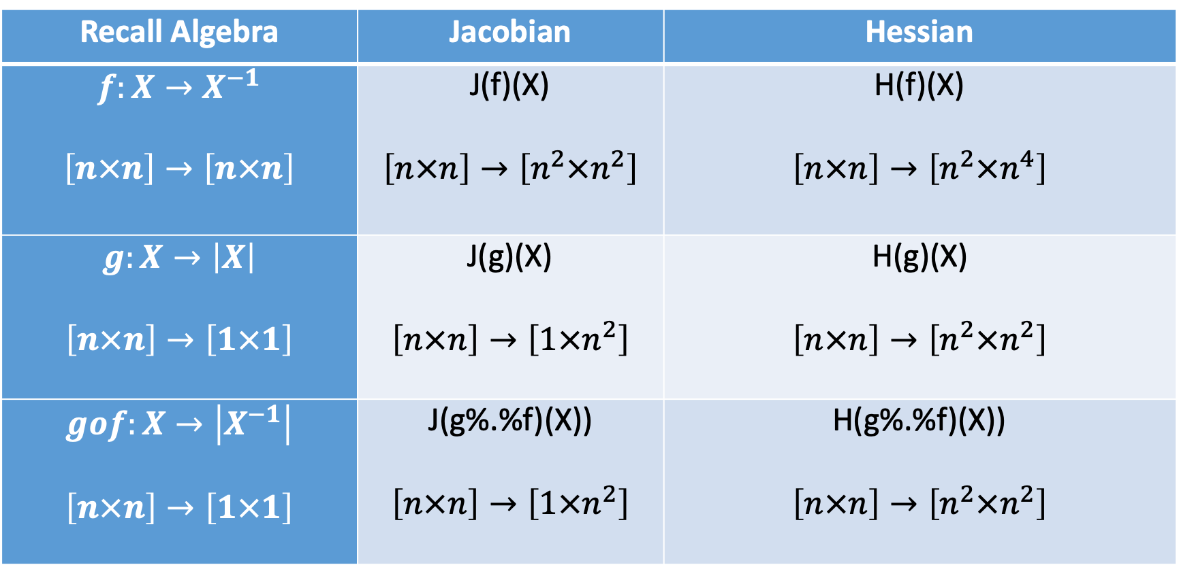
Simple Illustration of RcppEigenAD, part 2
Recall Algebra | Jacobian | Hessian
$$f:X→X^{−1}$$ $$\left[n×n\right]→\left[n×n\right]$$ | J(f)(X) $$\left[n×n\right]→\left[n^{2}×n^{2}\right]$$ | H(f)(X) $$\left[n×n\right]→\left[{n^{2}×n}^{4}\right]$$
$$g:X→\left|X\right|$$ $$\left[n×n\right]→\left[1×1\right]$$ | J(g)(X) $$\left[n×n\right]→\left[{1×n}^{2}\right]$$ | H(g)(X) $$\left[n×n\right]→\left[{n^{2}×n}^{2}\right]$$
$$gof:X→\left|X^{−1}\right|$$ $$\left[n×n\right]→\left[1×1\right]$$ | J(g%.%f)(X)) $$\left[n×n\right]→\left[{1×n}^{2}\right]$$ | H(g%.%f)(X)) $$\left[n×n\right]→\left[{n^{2}×n}^{2}\right]$$

Slide 7
Illustration, R results for a 2 by 2 matrix, part 1
> X<-matrix(c(1,2,3,4),2,2)
> f(X) # The inverse
[,1] [,2]
[1,] -2 1.5
[2,] 1 -0.5
> g(X) # The determinant
[,1]
[1,] -2
> # The determinant of the inverse
> (g%.%f)(X)
[,1]
[1,] -0.5
>

Slide 8
Illustration, R results for a 2 by 2 matrix, part 2
> J(f)(X) # Jacobian of the inverse [nxn]
[,1] [,2] [,3] [,4]
[1,] -4.0 2.0 3.00 -1.50
[2,] 3.0 -1.0 -2.25 0.75
[3,] 2.0 -1.0 -1.00 0.50
[4,] -1.5 0.5 0.75 -0.25
> H(f)(X) # Hessian of the inverse [nxn²]
[,1] [,2] [,3] [,4] [,5] [,6] [,7] [,8] [,9] [,10] [,11] [,12] [,13]
[1,] -16 8.0 12.00 -6.00 12.00 -5.00 -9.00 3.75 8.0 -4 -5.00 2.50 -6.00
[2,] 8 -4.0 -5.00 2.50 -5.00 2.00 3.00 -1.25 -4.0 2 2.00 -1.00 2.50
[3,] 12 -5.0 -9.00 3.75 -9.00 3.00 6.75 -2.25 -5.0 2 3.00 -1.25 3.75
[4,] -6 2.5 3.75 -1.50 3.75 -1.25 -2.25 0.75 2.5 -1 -1.25 0.50 -1.50
[,14] [,15] [,16]
[1,] 2.50 3.75 -1.50
[2,] -1.00 -1.25 0.50
[3,] -1.25 -2.25 0.75
[4,] 0.50 0.75 -0.25

Slide 9
Illustration, R results for a 2 by 2 matrix, part 3
> J(g)(X) # Jacobian of the determinant [1xn]
[,1] [,2] [,3] [,4]
[1,] 4 -2 -3 1
> H(g)(X) # Hessian of the determinant [n²xn²]
[,1] [,2] [,3] [,4]
[1,] 0 0 0 1
[2,] 0 0 -1 0
[3,] 0 -1 0 0
[4,] 1 0 0 0
> J(g%.%f)(X) # Jacobian of the determinant of the inverse [1xn²]
[,1] [,2] [,3] [,4]
[1,] -1 0.5 0.75 -0.25
> H(g%.%f)(X) # Hessian of the determinant of the inverse [nxn]
[,1] [,2] [,3] [,4]
[1,] -4.00 2.00 3.00 -1.25
[2,] 2.00 -1.00 -1.25 0.50
[3,] 3.00 -1.25 -2.25 0.75
[4,] -1.25 0.50 0.75 -0.25

Slide 10
Functional decomposition of a statistical model
  Data, design matrix, transformations
  Model, a function of the data
  Log-Likelihood, a function of the Model and the Data
We can obtain any cross derivatives of the parts and their components via Faà di Bruno's formula (an identity which generalizes the chain rule to higher order derivatives)

Slide 11
Statistical Model Applications:
model estimation (using the 1st and 2nd derivatives to maximize a function)
model interpretation (the delta method is used to produce SE of the model’s marginal effects)
model criticism (the implicit function theorem is used to check for the model’s internal validity)
On a logit model of the Finney (1971) data.
Notes:
Finney, D.J., (1971), Probit Analysis, 3rd ed. Cambridge, UK, Cambridge University Press

Slide 12
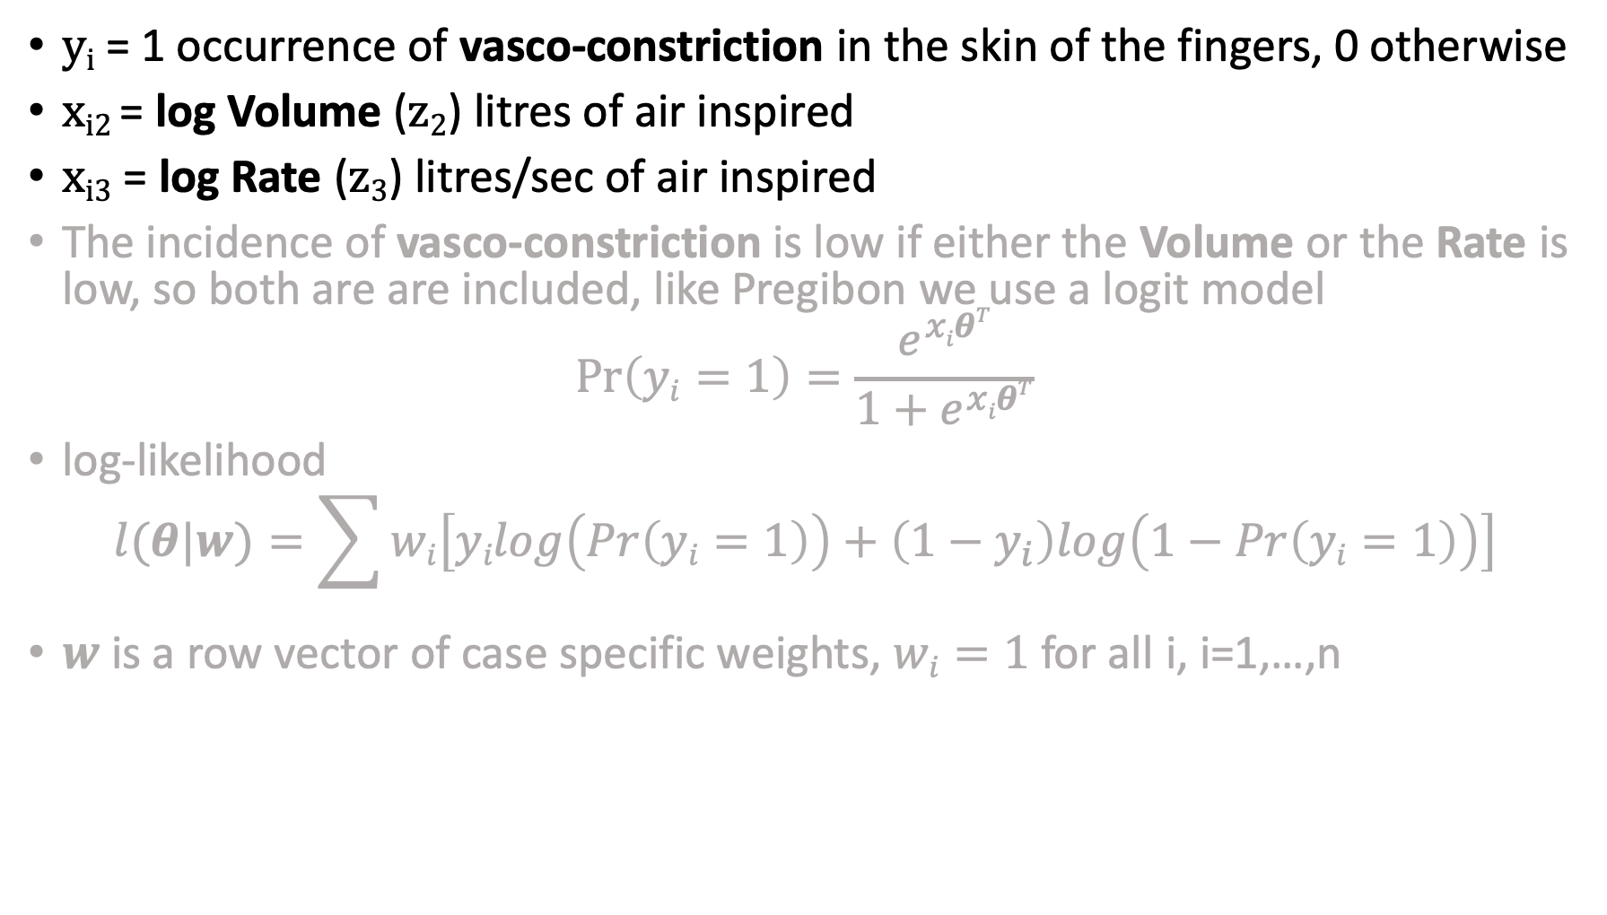
The Finney (1971) experimental data, n=39
y_{i} = 1 occurrence of vasco-constriction in the skin of the fingers, 0 otherwise
x_{i2} = log Volume (z₂) litres of air inspired
x_{i3} = log Rate (z₃) litres/sec of air inspired
The incidence of vasco-constriction is low if either the Volume or the Rate is low, so both are are included, like Pregibon we use a logit model
$$\operatorname{Pr}\left(yi=1\right)=\frac{e^{xiθT}}{1+e^{xiθT}}$$
log-likelihood
$$l(θ|w)=\sum{wi\left[yilog\left(Pr\left(yi=1\right)\right)+\left(1−y_{i}\right)log\left(1−Pr\left(yi=1\right)\right)\right]}$$
$w$ is a row vector of case specific weights, $wi=1$for all i, i=1,…,n

Slide 13
Example 1. maxLik with AD for the J and H gives
Maximum Likelihood estimation
Newton-Raphson maximisation, 6 iterations
Return code 1: gradient close to zero
Log-Likelihood: -14.61369
3 free parameters
Estimates:
Estimate Std. error
theta1 -2.875 1.321 # constant
theta2 5.179 1.865 # ln(Vol)
theta3 4.562 1.838 # ln(Rate)
Same as the result give by maxLik with analytical derivatives,
using AD we can easily do this for any model with a couple of lines of R code

Slide 14
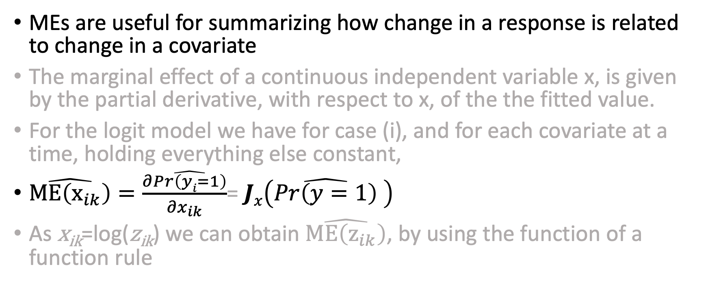
Example 2: RcppEigenAD and model Interpretation
MEs are useful for summarizing how change in a response is related to change in a covariate
The marginal effect of a continuous independent variable x, is given by the partial derivative, with respect to x, of the the fitted value.
For the logit model we have for case (i), and for each covariate at a time, holding everything else constant,
$\hat{ME\left(x_{ik}\right)}=\frac{∂\hat{Pr\left(yi=1\right)}}{{∂x}_{ik}}$= $Jx\left(\hat{Pr\left(y=1\right)} \right)$
As x_{ik}=log(z_{ik}) we can obtain $\hat{ME\left(z_{ik}\right)}$, by using the function of a function rule
Notes:
https://cran.r-project.org/web/packages/margins/index.html

Slide 15

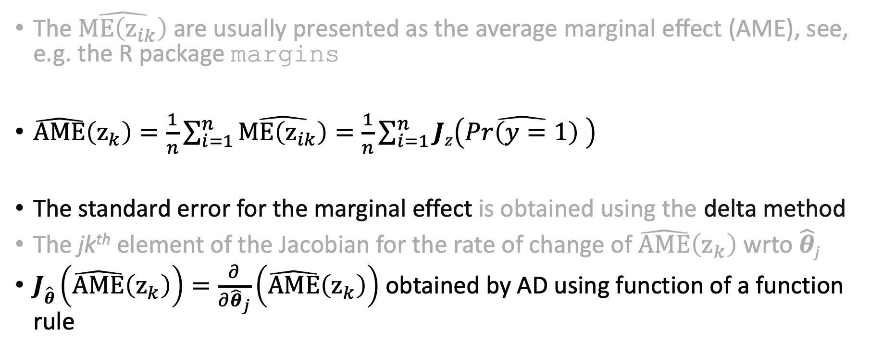
Average Marginal Effects, $\hat{AME}\left(z_{k}\right)$
The $\hat{ME\left(z_{ik}\right)}$ are usually presented as the average marginal effect (AME), see, e.g. the R package margins
$\hat{AME}\left(z_{k}\right)=\frac{1}{n}\sum_{i=1}^{n}{\hat{ME\left(z_{ik}\right)}}=\frac{1}{n}\sum_{i=1}^{n}{Jz\left(\hat{Pr\left(y=1\right)} \right)}$
The standard error for the marginal effect is obtained using the delta method
The jk^{th} element of the Jacobian for the rate of change of $\hat{AME}\left(z_{k}\right)$wrto $\hat{θ}$_{j}
$J\hat{θ}\left(\hat{AME}\left(z_{k}\right)\right)=\frac{∂}{{∂\hat{θ}}_{j}}\left(\hat{AME}\left(z_{k}\right)\right)$ obtained by AD using function of a function rule

Slide 16
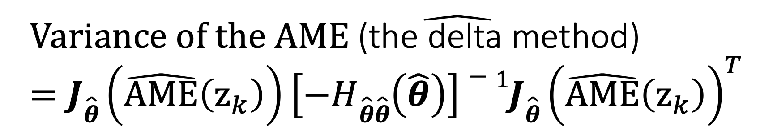
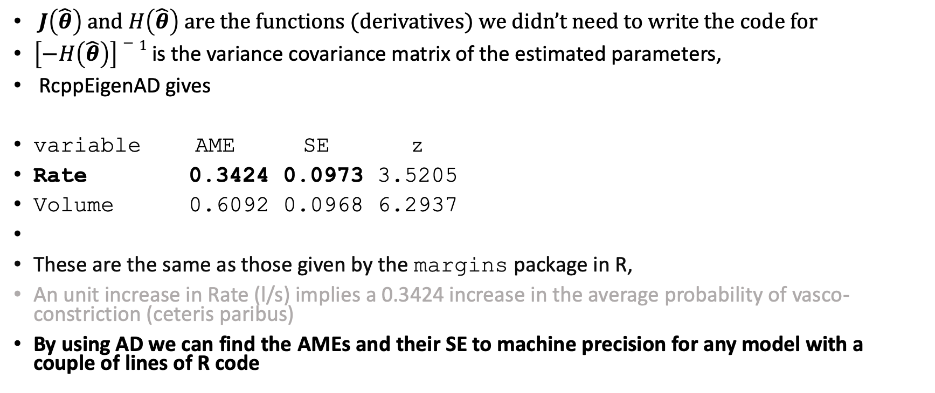
$$Variance of the \hat{AME \text{(}\text{the} \text{delta} \text{method}\text{)}}=J\hat{θ}\left(\hat{AME}\left(z_{k}\right)\right)\left[−H\hat{θ}\hat{θ}\left(\hat{θ}\right)\right]−1{J\hat{θ}\left(\hat{AME}\left(z_{k}\right)\right)}^{T}$$
$J\left(\hat{θ}\right)$ and $H\left(\hat{θ}\right) are$ the functions (derivatives) we didn’t need to write the code for
$\left[−H\left(\hat{θ}\right)\right]−1$ is the variance covariance matrix of the estimated parameters,
RcppEigenAD gives
variable AME SE z
Rate 0.3424 0.0973 3.5205
Volume 0.6092 0.0968 6.2937
These are the same as those given by the margins package in R,
An unit increase in Rate (l/s) implies a 0.3424 increase in the average probability of vasco-constriction (ceteris paribus)
By using AD we can find the AMEs and their SE to machine precision for any model with a couple of lines of R code

Slide 17
Example 3: Using RcppEigenAD for model criticism
Influence statistics provide a measure of the stability of the model’s outputs with respect to the data components, they can indicate the degree of change in the model outputs when a data point/case (or group of cases) is dropped
This could be important if some elements of the data set have been corrupted or if the model is not appropriate for a subset of the data
There are many tools that can be used to detect influential observations, e.g. Cook’s D, DFBETAs, DFFITs, and Studentized Residuals
We only consider the role of RcppEigenAD for DFBETAs

Slide 18
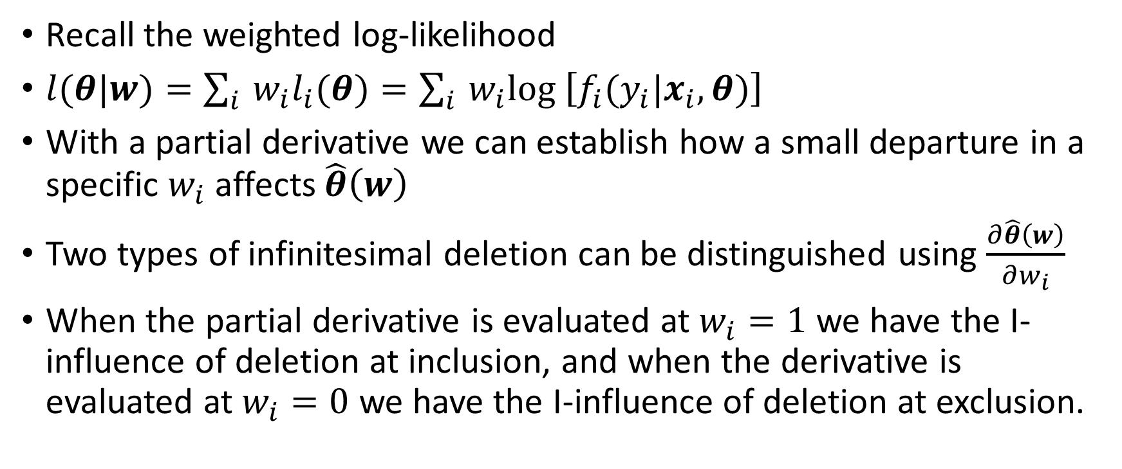
Infinitesimal Influence
Recall the weighted log-likelihood
$l(θ|w)=\sum_{i}{‍}w_{i}l_{i}(θ)=\sum_{i}{‍}w_{i}log$ $\left[f_{i}(y_{i}|x_{i},θ)\right]$
With a partial derivative we can establish how a small departure in a specific $w_{i}$ affects $\hat{θ}\left(w\right)$
Two types of infinitesimal deletion can be distinguished using $\frac{∂\hat{θ}\left(w\right)}{∂w_{i}}$
When the partial derivative is evaluated at $w_{i}=1$ we have the I-influence of deletion at inclusion, and when the derivative is evaluated at $w_{i}=0$ we have the I-influence of deletion at exclusion.
Notes:
For more on II see Ch 9 of
Demidenko, E., (2013), Mixed Models: Theory and Applications with R, 2nd Edition, Wiley, New York
Pregibon, D., (1981), Logistic Regression diagnostics, Annals of Statistics, 4, 705-724

Slide 19
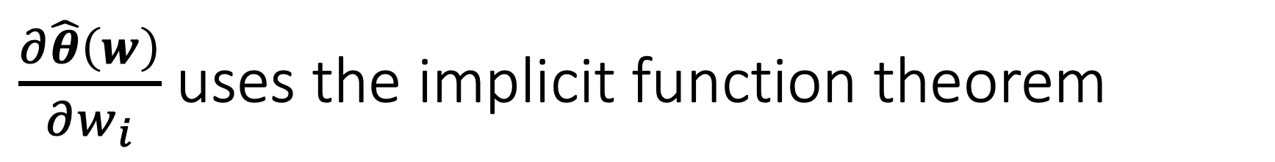
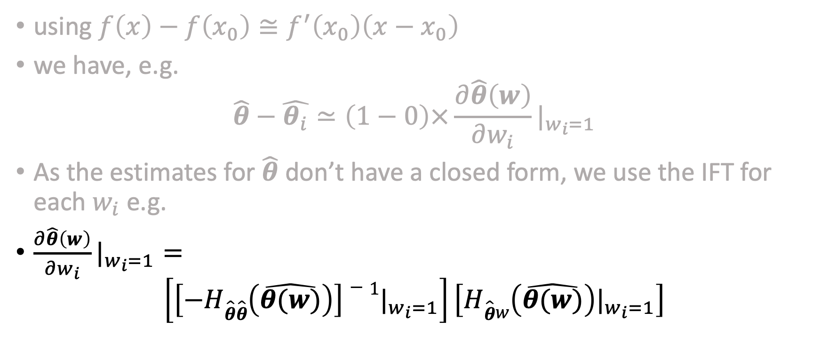
$\frac{∂\hat{θ}\left(w\right)}{∂w_{i}}$ uses the implicit function theorem
using $f\left(x\right)−f\left(x_{0}\right)≅f^{′}\left(x_{0}\right)\left({x−x}_{0}\right)$
we have, e.g.
$\hat{θ}−\hat{θ_{i}}≃\left(1−0\right)×\frac{∂\hat{θ}\left(w\right)}{∂w_{i}}|_{w_{i}=1}$
As the estimates for $\hat{θ}$ don’t have a closed form, we use the IFT for each $w_{i}$ e.g.
$\frac{∂\hat{θ}\left(w\right)}{∂w_{i}}|_{w_{i}=1}=$
$$\left[\left[−H\hat{θ}\hat{θ}\left(\hat{θ(w)}\right)\right]−1|_{w_{i}=1}\right]\left[H\hat{θ}w\left(\hat{θ(w)}\right)|_{w_{i}=1}\right]$$

Slide 20
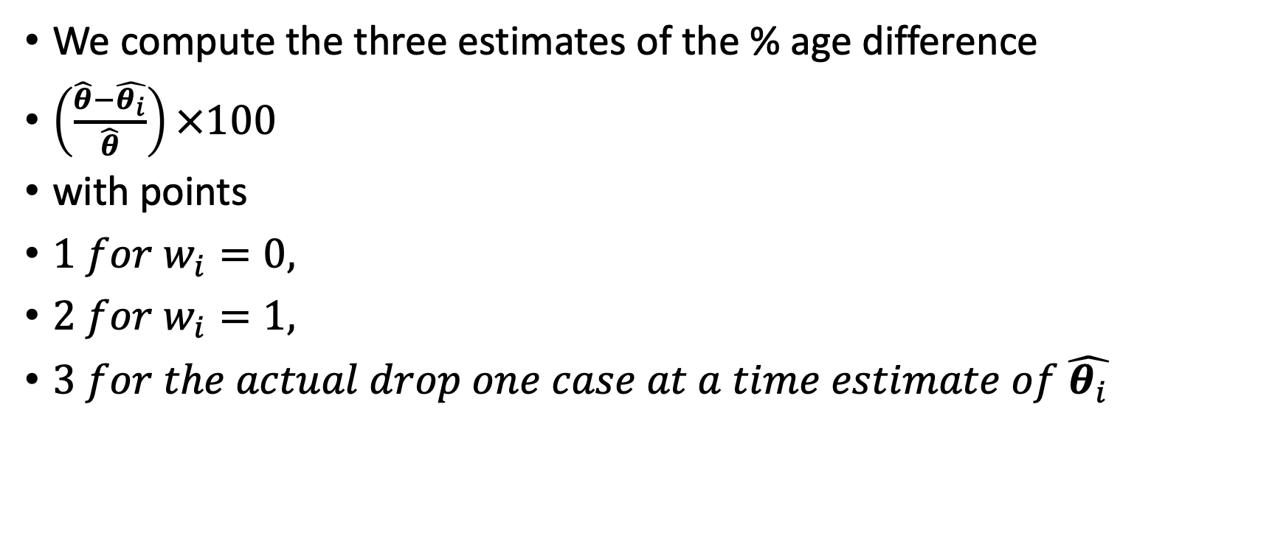
Infinitesimal Influence: DFBETA
We compute the three estimates of the % age difference
$\left(\frac{\hat{θ}−\hat{θ_{i}}}{\hat{θ}}\right)×100$
with points
$1 for{ w}_{i}=0,$
$2 for{ w}_{i}=1,$
$3 for the actual drop one case at a time estimate of \hat{θ_{i}}$

Slide 21
Infinitesimal Influence: DFBETAs Example

Slide 22
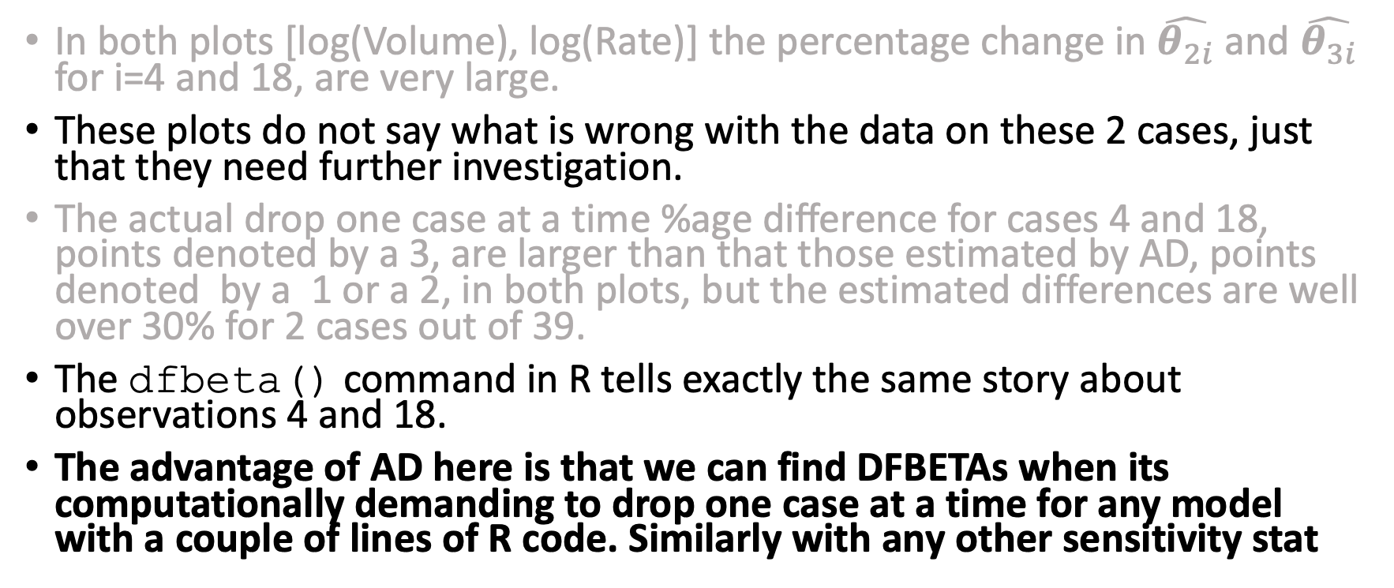
Infinitessimal Influence: Example
In both plots [log(Volume), log(Rate)] the percentage change in $\hat{θ_{2i}}$ and $\hat{θ_{3i}}$ for i=4 and 18, are very large.
These plots do not say what is wrong with the data on these 2 cases, just that they need further investigation.
The actual drop one case at a time %age difference for cases 4 and 18, points denoted by a 3, are larger than that those estimated by AD, points denoted by a 1 or a 2, in both plots, but the estimated differences are well over 30% for 2 cases out of 39.
The dfbeta() command in R tells exactly the same story about observations 4 and 18.
The advantage of AD here is that we can find DFBETAs when its computationally demanding to drop one case at a time for any model with a couple of lines of R code. Similarly with any other sensitivity stat

Slide 23
Summary
RcppEigenAD has eliminated the need to write code for derivatives
RcppEigenAD means statistical modellers have the tools to help with;
  estimation
  Interpretation
  sensitivity analysis
  of any model new or otherwise
Which could imply better science in less time
Different components (i.e. not data, model, estimation) could be used in other areas e.g. data reduction

