Slide 1
A DevOps process for deploying R to production
David Smith Cloud Advocate, Microsoft @revodavid
Notes:
So you've built an amazing model in R. It generates great predictions or recommendations on your desktop. Now, how do you get it into production?
Deploying R functions within Docker containers, and exposing them with the 'plumber' package, is a simple and effective way to integrate R into applications via a REST API. We can further provide scale for high-volume workloads by deploying that container to Kubernetes. As the complexity grows, however, managing and updating deployments can be challenging.
In this talk, we describe a CI/CD based process in Azure DevOps to automate the entire build, test and deploy process for R-based models in production. The process emphasizes model reproducibility, by capturing and tracking changes in the code, data, tests and configurations that define the model. You will learn how, with a check-in to GitHub as the trigger, your model can be automatically retrained, optimized, built, validated, and — with human approval if necessary — released. Once deployed to the production environment — in this talk we'll focus on scalable open-source frameworks like Kubernetes — the model will be subject to continuous monitoring and performance tracking until such time that a new model version is warranted, and the DevOps lifecycle begins again.

Slide 2
What is DevOps?
People. Process. Products.
Build& Test
Deploy
DevOps is the union of people, process, and products to enable continuous delivery of value to your end users.
“
Continuous Delivery
Develop
Operate
”
Donovan Brown, Microsoft
http://bit.ly/WhatIs-DevOps
Plan & Track
Monitor & Learn
Notes:
DevOps is the union of people, process and products to enable the continuous delivery of value to your end customers

Slide 3
Machine Learning Applications
A / अ
Self-driving cars
Machine Translation
Predictive maintenance
Image recognition
Forecasting
…
E-commerce recommendations
Genomics

Slide 4
Example: Automatic windscreen wipers
"rain on windscreen" by grace_kat licensed under CC BY-SA 2.0

Slide 5
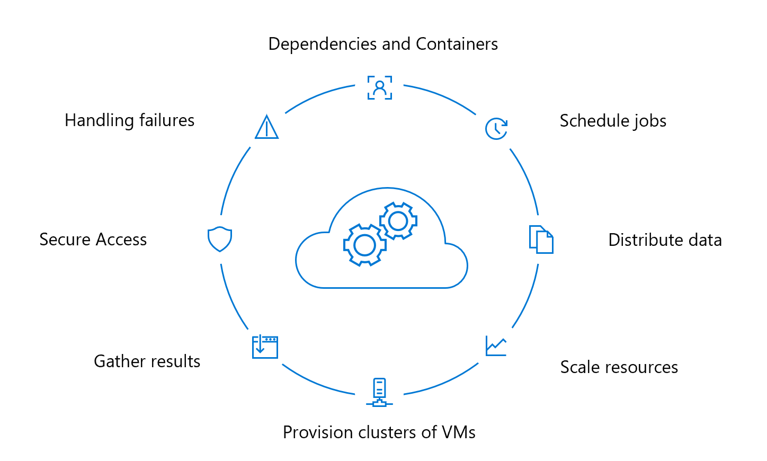
Special considerations for MLOps
People: Data Scientists, ML Engineers
Process:
Data as Code
Model Lifecycle
Tests
Deployed APIs
Products:
Hardware: Storage, GPUs
Software: Datastores, Analytics Tools (R, Python, Tensorflow…)

Slide 6
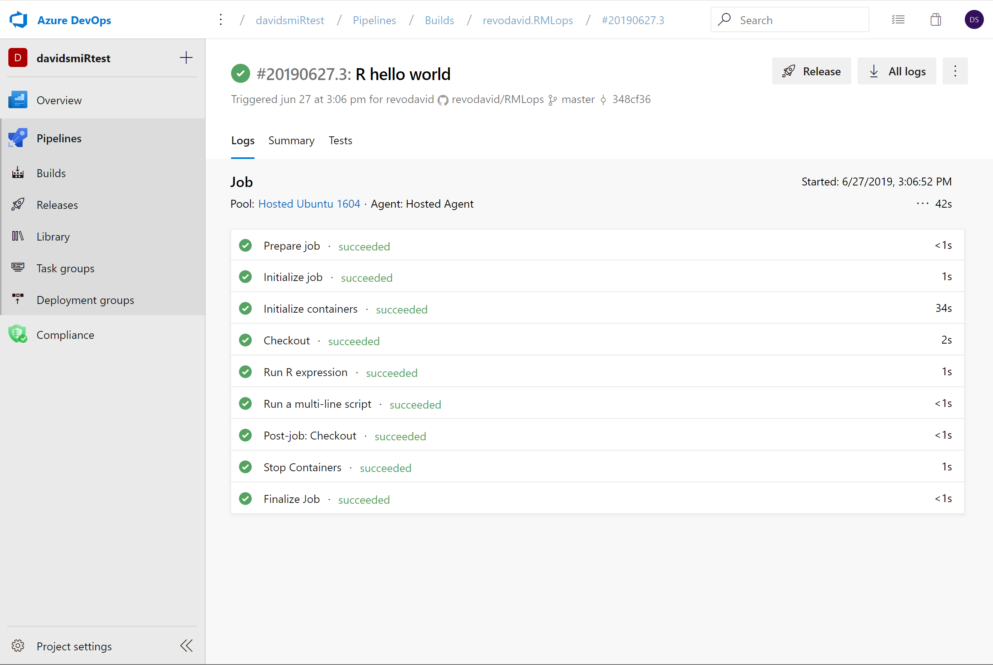
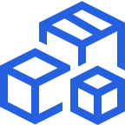
Azure Pipelines
Cloud-hosted pipelines for Linux, Windows and macOS, with unlimited minutes for open source
Any language, any platform, any cloud
Build, test, and deploy Node.js, Python, Java, PHP, Ruby, C/C++, .NET, Android, and iOS apps. Run in parallel on Linux, macOS, and Windows. Deploy to Azure, AWS, GCP or on-premises
Extensible
Explore and implement a wide range of community-built build, test, and deployment tasks, along with hundreds of extensions from Slack to SonarCloud. Support for YAML, reporting and more
Containers and Kubernetes
Easily build and push images to container registries like Docker Hub and Azure Container Registry. Deploy containers to individual hosts or Kubernetes.
Best-in-class for open source
Ensure fast continuous integration/continuous delivery (CI/CD) pipelines for every open source project. Get unlimited build minutes for all open source projects with up to 10 free parallel jobs across Linux, macOS and Windows
➔
https://azure.com/pipelines
Notes:
Azure Pipelines is the perfect launchpad for your code – automating your builds and deployments so you spend less time with the nuts and bolts and more time being creative

Slide 7
Training R Models with Azure Pipelines
In Github Repo:
github.com/revodavid/RMLOps
Data files
R scripts
YAML Pipeline specification
Status Badge
In Azure Pipelines:
dev.azure.com/ davidsmi0786/davidsmiRtest
Triggers
Build pipeline(s)
Release pipeline(s)

Slide 8
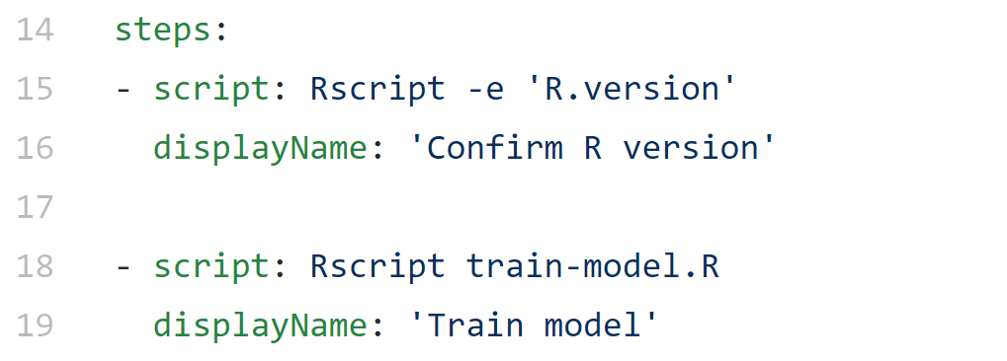
Azure Pipelines: Process
Create Azure Pipeline with Github repository
Link RStudio project to Github repository
Develop R code as R script files as usual
Add steps to azure-pipelines.yml with Rscript commands
Check in updates to trigger builds

Slide 9
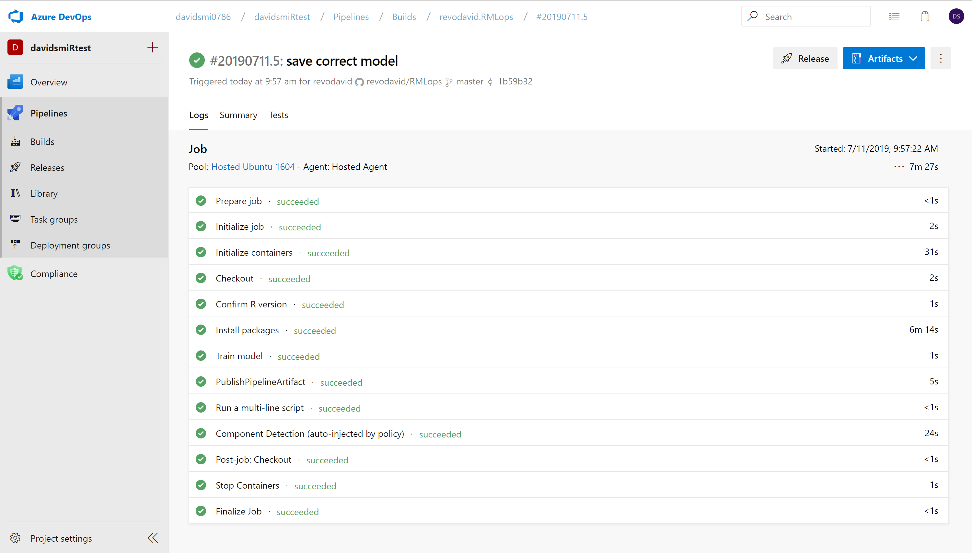
Azure Pipelines Screenshot

Slide 10
Containers and Azure Pipelines
Specify a container with your desired R version, packages, and any other software needed.
Container images can be hosted anywhere
Docker Hub, your own container registry, Azure Container Registry …
Tip 1: The “Rocker” project provides pre-defined R containers for training: https://www.rocker-project.org/
Tip 2: You can also deploy with containers using the AzureContainers package: https://blog.revolutionanalytics.com/2018/12/azurecontainers.html

Slide 11
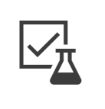
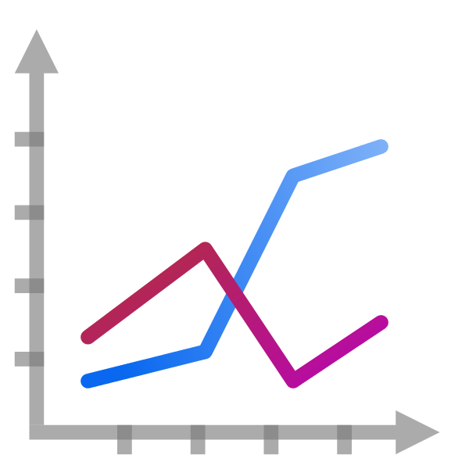
The End-to-End Machine Learning Model Lifecycle
Develop & train model with reusable ML pipelines
Package model using containers to capture runtime dependencies for inference
Validate model behavior—functionally, in terms of responsiveness, in terms of regulatory compliance
Deploy model—to cloud & edge, for use in real-time/streaming/batch processing
Monitor model behavior & business value, know when to replace/deprecate a stale model
Train Model
Package Model
Validate Model
Deploy Model
Monitor Model
Retrain Model

Slide 12
What is Azure Machine Learning service?
Set of Azure Cloud Services
Python SDK
That enables you to:
Prepare Data
Build Models
Train Models
Manage Models
Track Experiments
Deploy Models

Slide 13
Azure Machine Learning Service
Use any tool and language
Share compute resources
Register versioned models
Containerized deployments
Monitor performance
Workspace
Experiments
Models
Images
Pipelines
Deployments
Compute Target
Data Stores

Slide 14
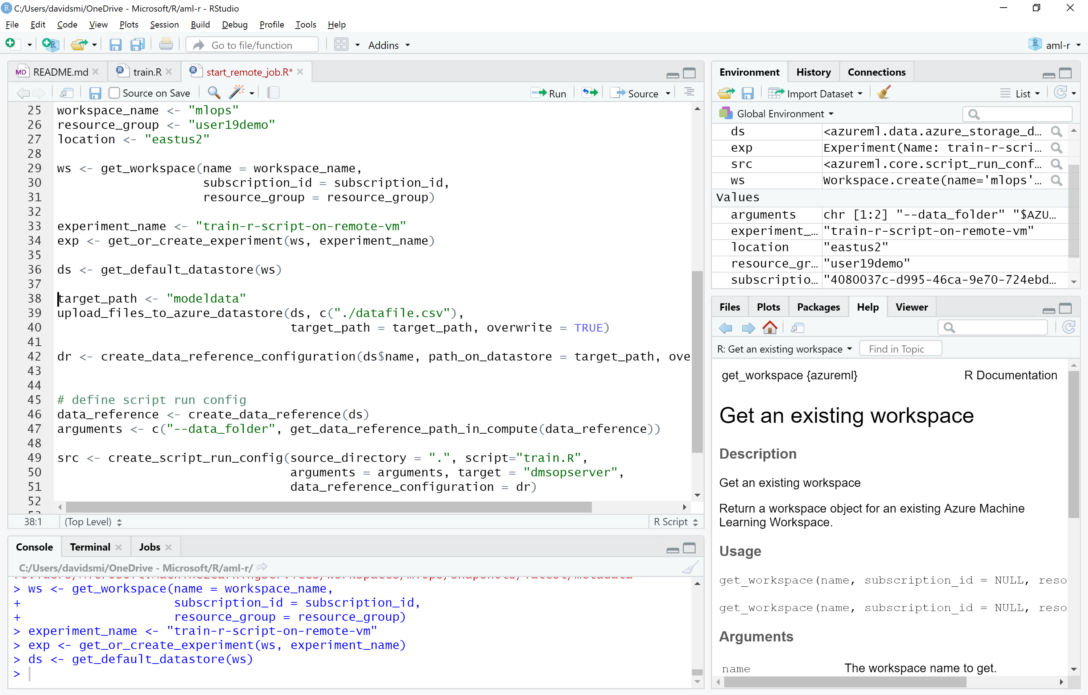
Coming Soon: Azure ML Service R SDK

Slide 15
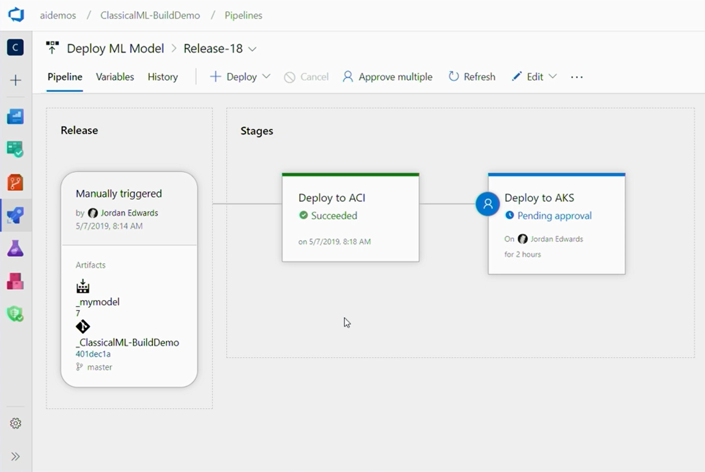
Pipelines with Azure MLOPS extension
Trigger builds/releases on model registration in Azure ML Services

Slide 16
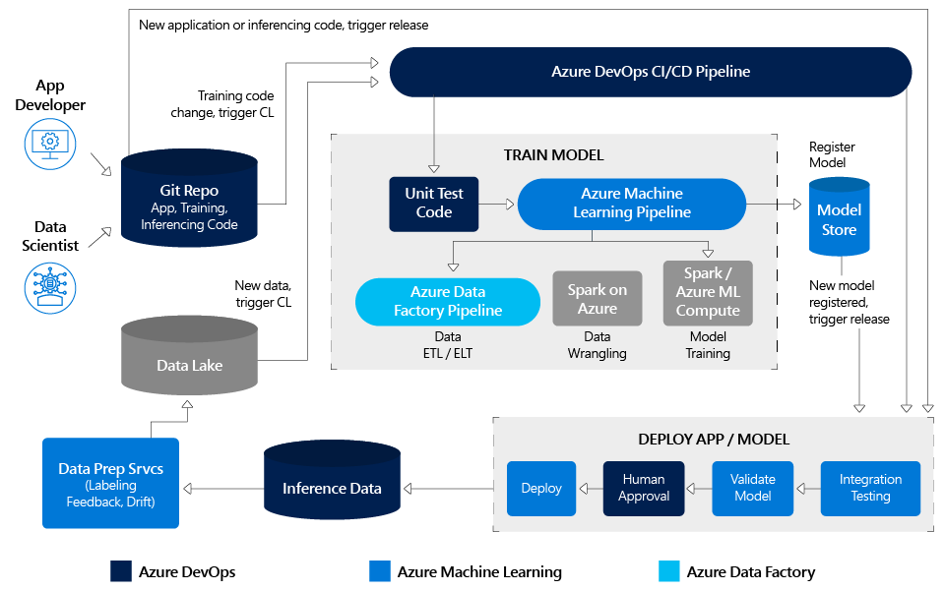
Complete MLOPS workflow

Slide 17
Azure Pipelines
Azure ML Service
Free unlimited build minutes for public projects
Up to 10 free parallel jobs across Windows, Linux and macOS
Free worskpaces, experiments, model registry
Standard Azure rates for compute and deployment or use your own servers for free
➔
https://azure.com/pipelines
➔
https://azure.com/ml
Notes:
All the builds you need, using the power of Azure you get one service that gives you unlimited build minutes where you can build on Windows Mac and Linux in parallel using a single build YAML file.

Slide 18
Resources
Integrating the Data Science and App Development Cycles
Francesca Lazzeri, Microsoft Medium: https://aka.ms/AA5ib6c
MLOps: Manage, deploy, and monitor models with Azure Machine Learning Service
Microsoft Docs: https://aka.ms/AA5kjqo
Train and deploy machine learning models with Azure Pipelines
Microsoft Docs: https://aka.ms/AA5kjqq
Operationalizing R models using Python via Azure ML SDK
George Iordanescu, Microsoft
https://github.com/Microsoft/AMLSDKRModelsOperationalization
These Slides
https://github.com/revodavid/blob/master/RMLops/user2019slides.pdf
David Smith Cloud Advocate, Microsoft @revodavid

Slide 19
Thank you David Smith Cloud Advocate, Microsoft @revodavid

