Slide 1
Connecting R/R Markdown and Microsoft Word using StatTag for Collaborative Reproducibility
useR!
July 10, 2019
Toulouse, France
Leah J. Welty, PhD
Presented to: Insert relevant presenter information Calibri 16pt
Presented on: Month day, Year
Presented by: Insert relevant presenter information here

Slide 2
Disclosures
Joint work with:
Luke V. Rasmussen, Lead Software Developer
Abigail S. Baldridge, Senior Statistical Analyst
Eric W. Whitley, Software Developer
This project was supported, in part, by the National Institutes of Health's National Center for Advancing Translational Sciences, Grant Number UL1TR001422. The content is solely the responsibility of the developers and does not necessarily represent the official views of the National Institutes of Health.

Slide 3
Reproducible Research: Role of the Statistician
Challenges with Collaborations and Consultations
Statisticians take data, conduct analyses, generate report
(Happy) investigator/client
receives
(beautiful) report
Investigator/client arrives with data
R Markdown (or knitR) ideal
Reproducible +
Investigator/client comes back in a year with questions, we still know what we did
Investigator/client comes back with updated data, no problem to update
Reproducible –
Reproducibility only exists (to our knowledge) in the middle step
What if we have greater responsibilities and involvement?

Slide 4
MS Word is Ubiquitous for Manuscript Preparation
Clinical and Basic Sciences
“All text…should be in one double-spaced electronic document (preferably a Word Doc)”
“For submission and review, please submit the manuscript as a Word document. Do not submit your manuscript in PDF format.”
“Science prefers to receive files in Word’s .docx format.”
Notes:
Not necessarily in stats, but in all the medical journals – they want word documents.
http://www.nejm.org/page/author-center/manuscript-submission,
http://jamanetwork.com/journals/jama/pages/instructions-for-authors#SecManuscriptFileFormats,
http://www.sciencemag.org/site/feature/contribinfo/prep/

Slide 5
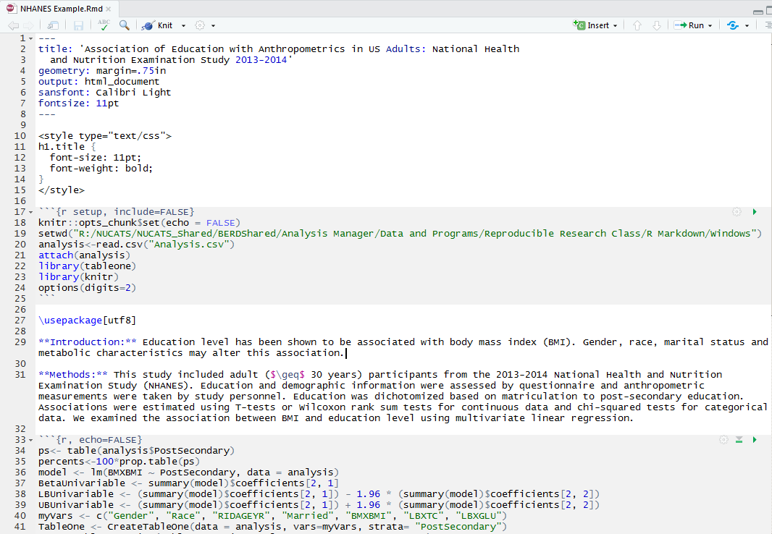
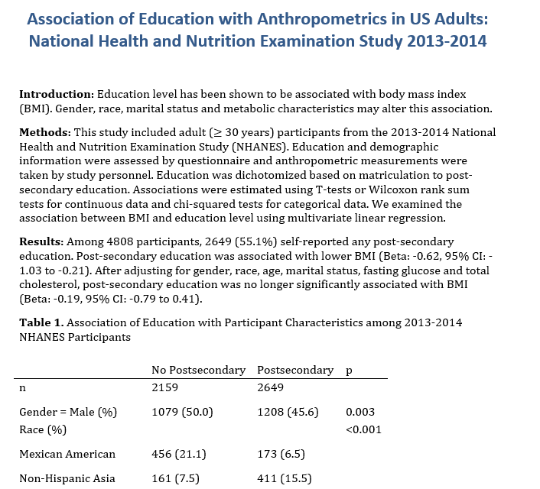
R Markdown and Microsoft Word
.Rmd file can generate a .rtf (.docx) file
Notes:
I can use R Markdown to produce a beautiful reproducible Word document that blends text with results. However, there are some limitations to this. First of all, I do not work with anyone who is willing to write in this type of document. My collaborators are primarily doctors who want to write in Word. I can send this beautiful Word document to my collaborators, and what they return to me usually looks like

Slide 6
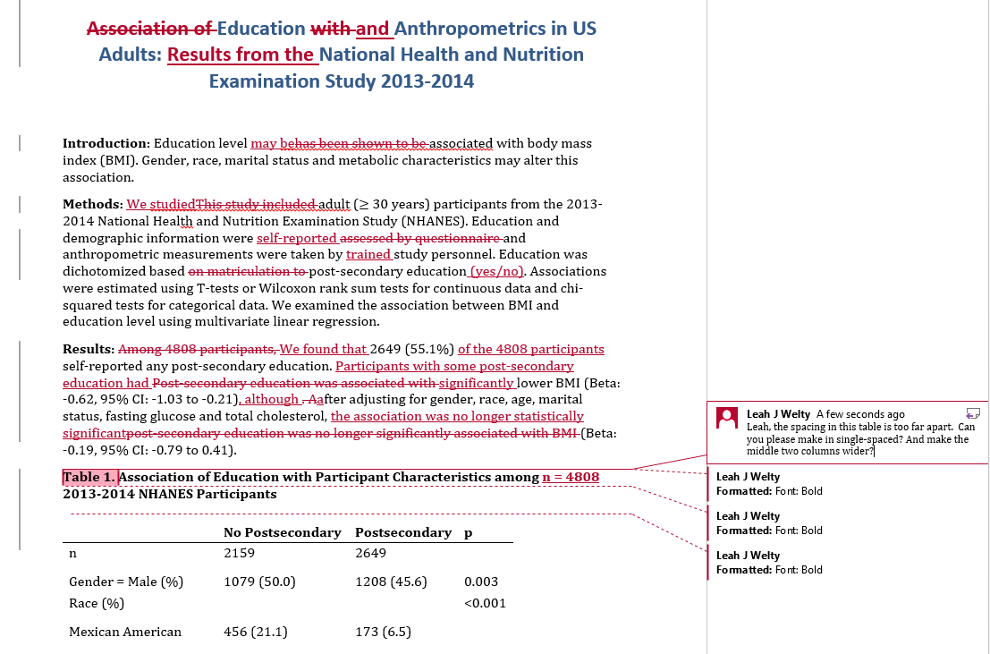
Practical Limitations
I send my collaborators the dynamic document, they send back:
Two bad choices:
Continue in Word, and lose reproducibility.
Re-enter all of their changes in my source “.rmd” file.
Notes:
This. I now have two choices, both of which are bad.

Slide 7
Practical Limitations
Collaborators and plain text editors
Markdown and knitR require drafting documents in a plain text editor:
Are your collaborators willing to work this way? My collaborators (primarily doctors and social scientists) are not.
Notes:
They want to write our manuscripts in Word.

Slide 8
StatTag: A complementary approach
Incorporate existing strengths, pragmatic
StatTag creates a link between a statistical code file and a Word document
Embeds output (values, tables, figures, verbatim) in document
Can work separately on the code and the Word document but retain link
Software agnostic: connects R, R Markdown (or Stata, SAS) to Word document
Can connect multiple code files to the same document
Notes:
Mention Mac and Windows versions!

Slide 9
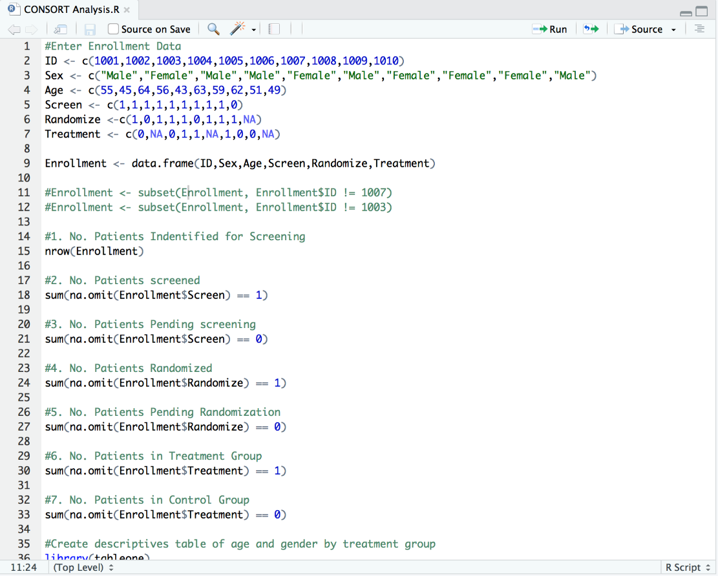
StatTag: How it Works
Step 1: Write your R/R Markdown code.

Slide 10
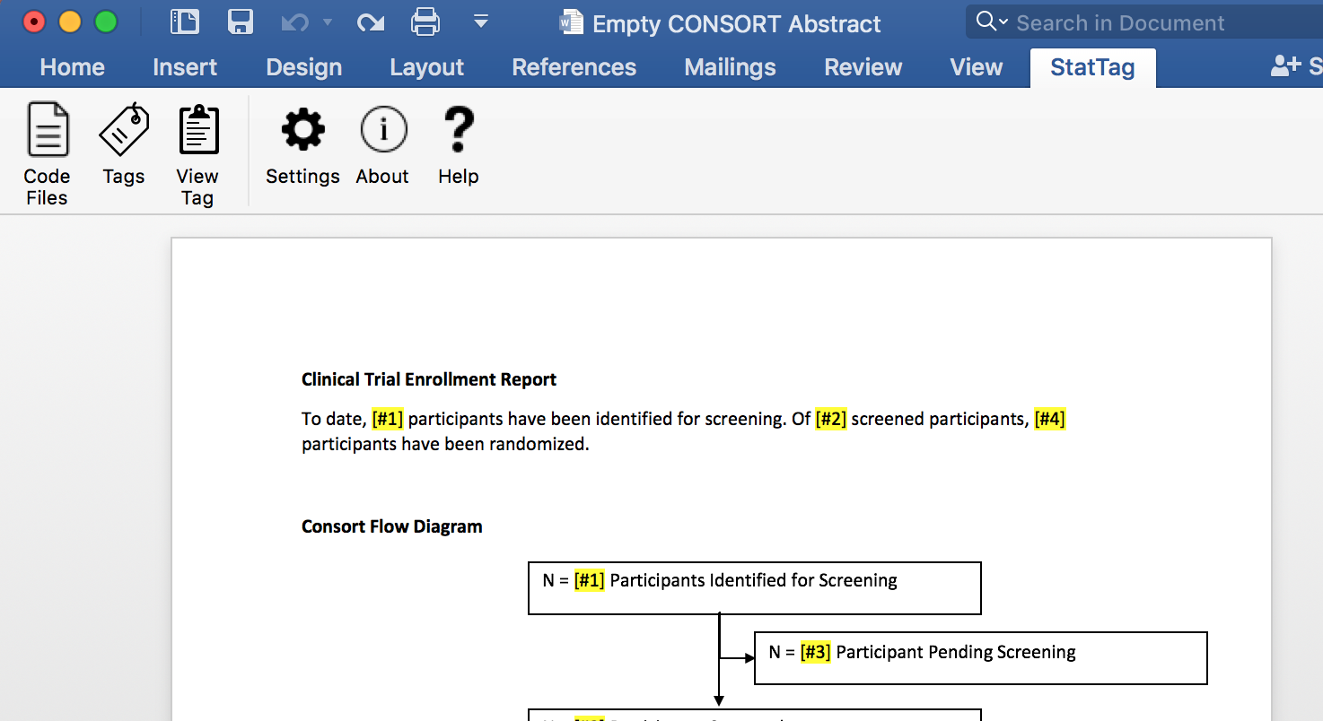
StatTag: How it Works
Step 2: Open Word and write some or all of your text.

Slide 11
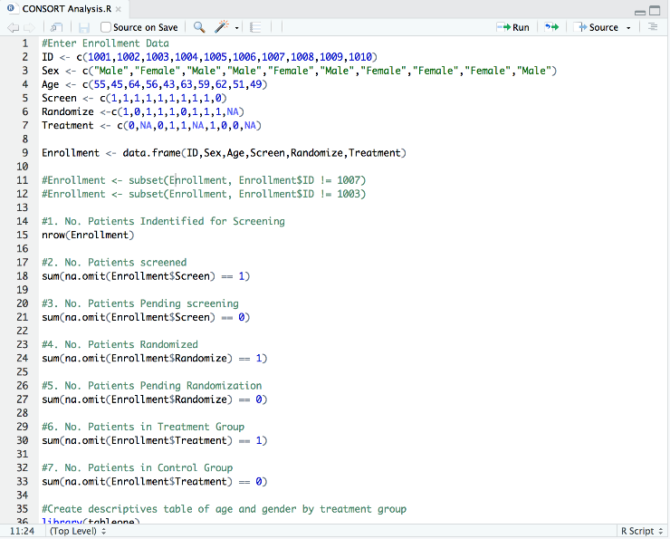
StatTag: How it Works
Step 3: Use StatTag to connect your code file to the Word document.

Slide 12
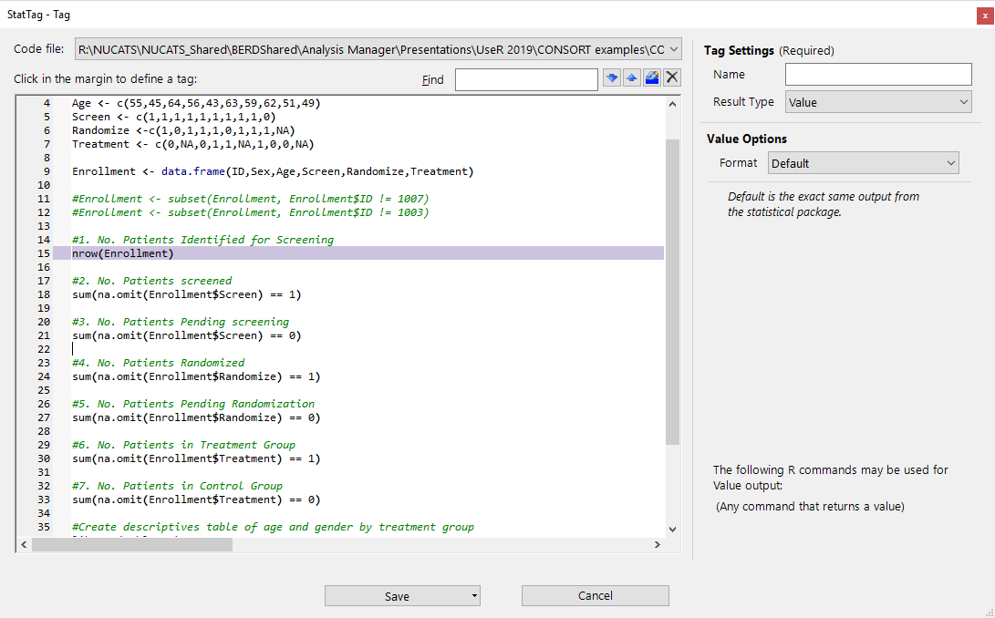
StatTag: How it Works
Step 4: Use StatTag to identify “tags” – portions of output that you want to insert – using a pop-up from Word.
Notes:
Need to update this screen shot for an R Markdown or and R example!!!

Slide 13
StatTag: How it Works
Step 5: Use StatTag to insert “tags” in your document. StatTag will run the code in the background and insert the results in to Word.

Slide 15
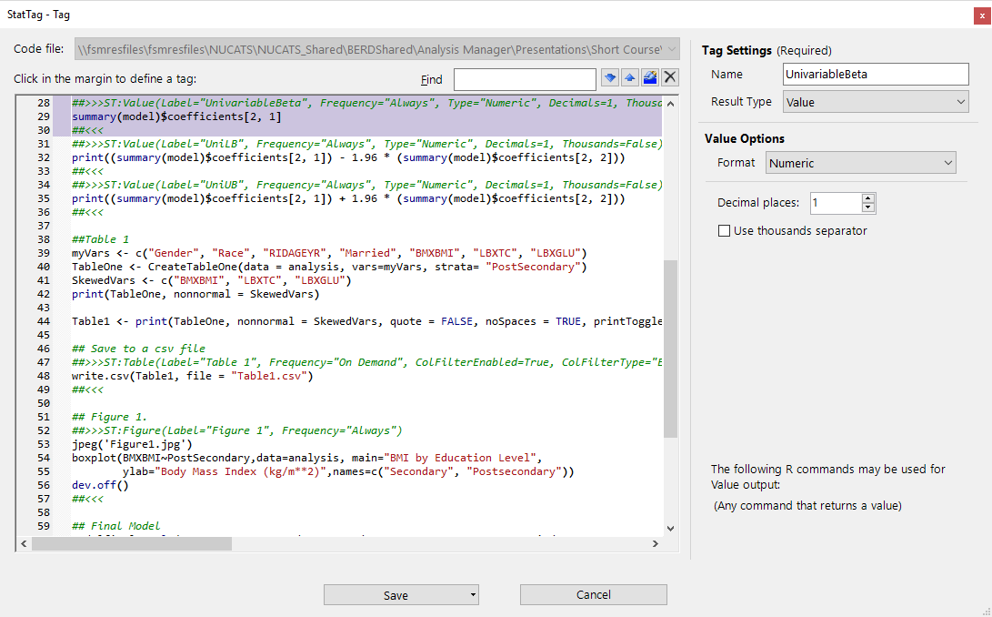
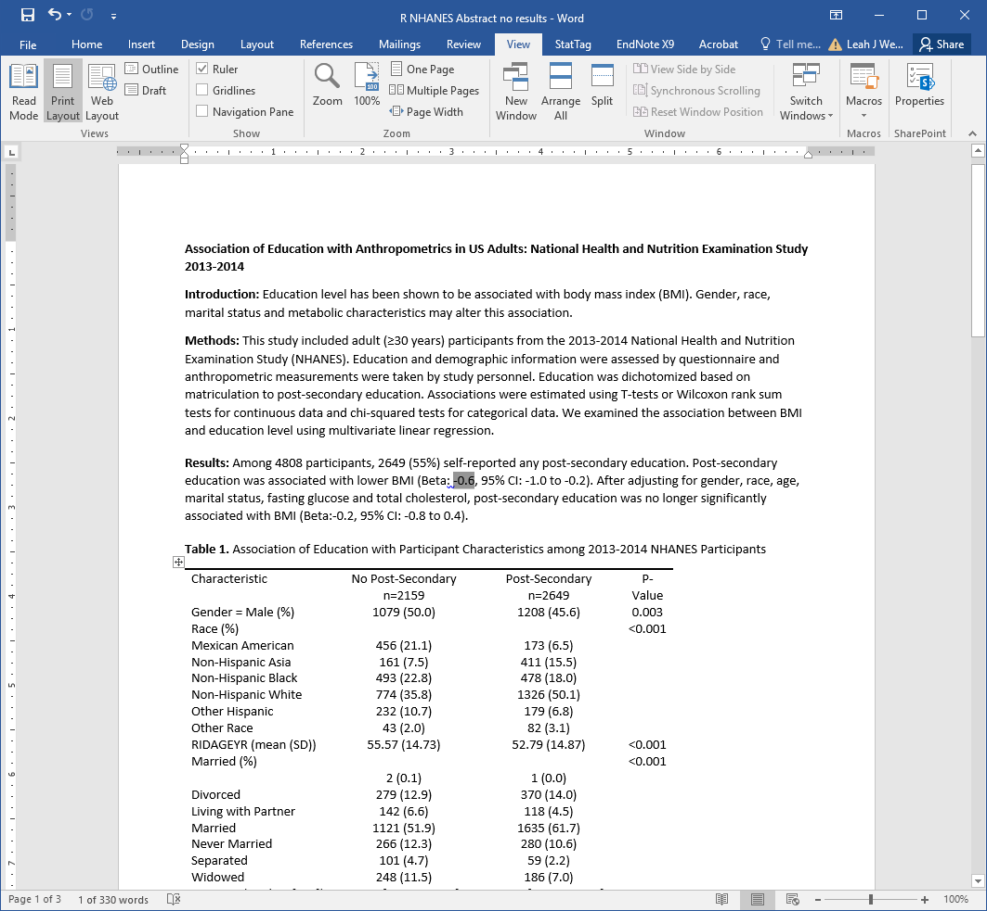
StatTag: How it Works
Double-clicking a tag brings up associated code
Notes:
Update with R logo here and throughout these slides

Slide 16
StatTag: How it works
Inserting tags directly in code, or using StatTag dialog box
**>>>ST:Value(Label=" ", Frequency="", Type="")
[R, SAS, or Stata code]
**<<<
**>>>ST:Table(Label="", Frequency="", Type="", AllowInvalid=True, Decimals=0, Thousands=False)
[R, SAS, or Stata code]
**<<<

Slide 17
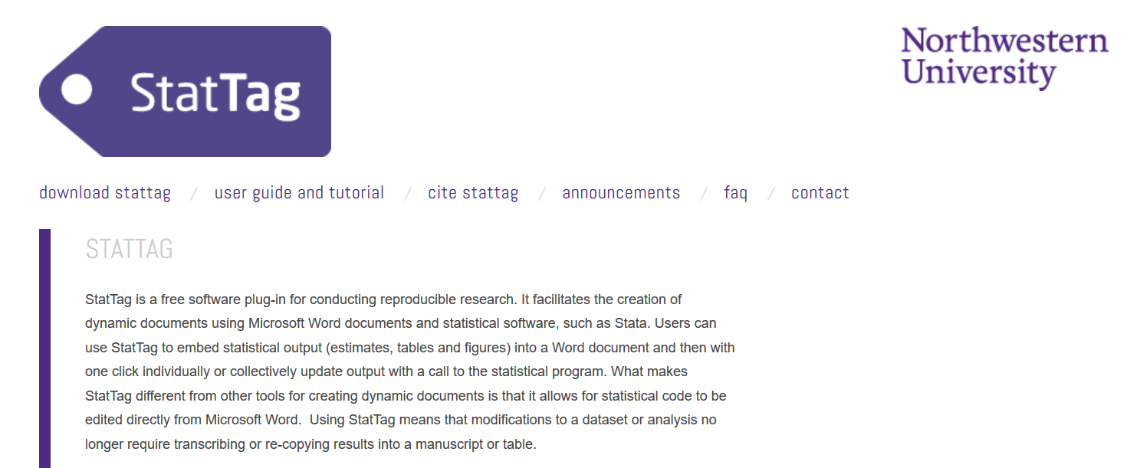
Getting StatTag
Freely available, open source, and evolving
stattag.org
Online course available at: https://canvas.instructure.com/enroll/DPCLGC
Or enter code DPCLGC at https://canvas.instructure.com/register

Slide 18
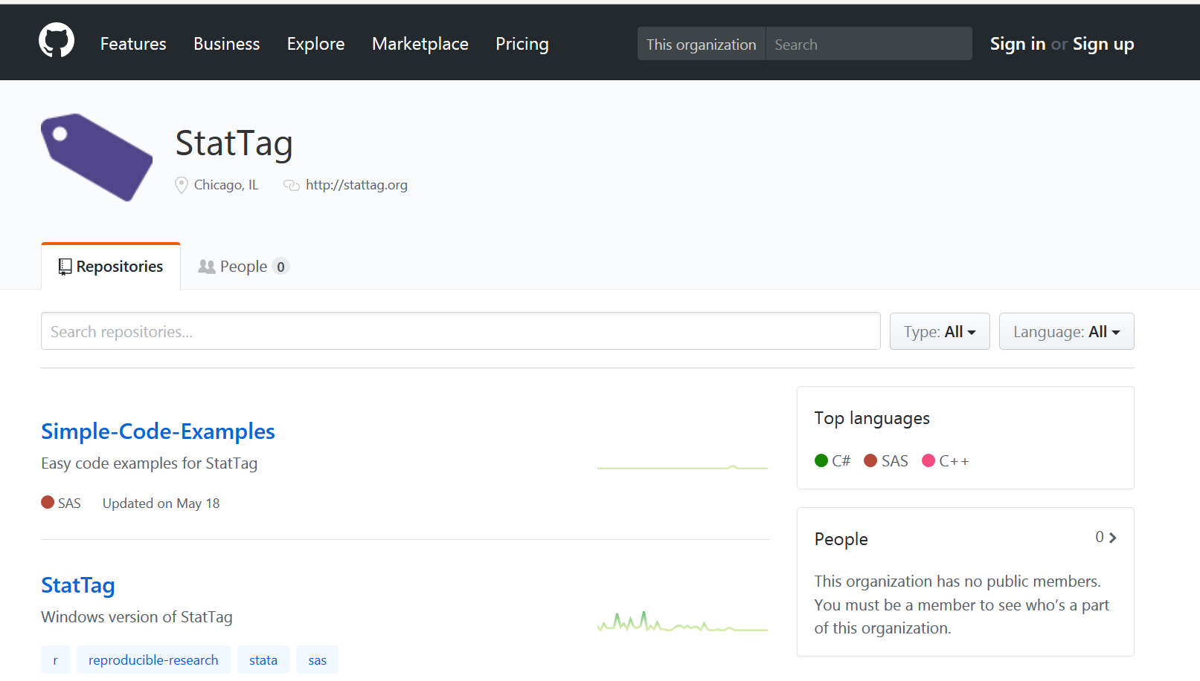
(Really) Getting StatTag
GitHub repo at github.com/StatTag

Slide 19
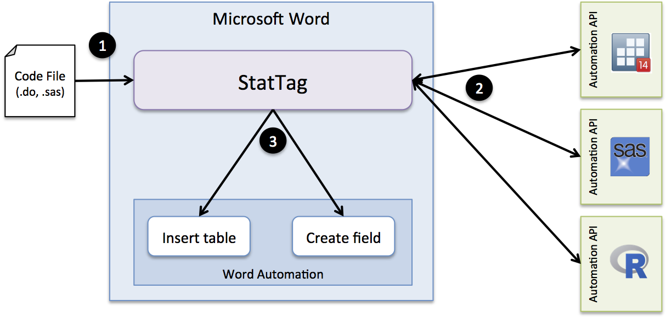
StatTag: Architecture
How we built it
(.do, .sas, .r)
Read the code file & parse out the tags
Send commands to the stat program and get individual results
Use Word automation to add results to the document (using native Word formatting for tables and fields).
Notes:
[SKIP/CUT IF NEEDED]

Slide 20
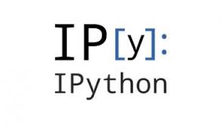
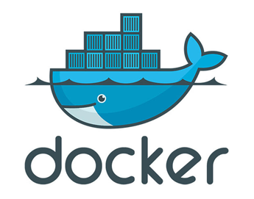
Future directions
Tech savvy tools to adopt for collaborative reproducibility
Version Control
Github
Subversion, cvs, etc.
Great tools, but what about WYSISYG or non-plain text files?
Electronic “lab notebooks”
Jupyter notebook
iPython
“Containers” (e.g. docker)
Facilitate packaging the code, data, packages, libraries and software program/environment together
Notes:
Problem is that these tools are largely intended for the quantitatively minded scientist who is comfortable working in plain text

Slide 21
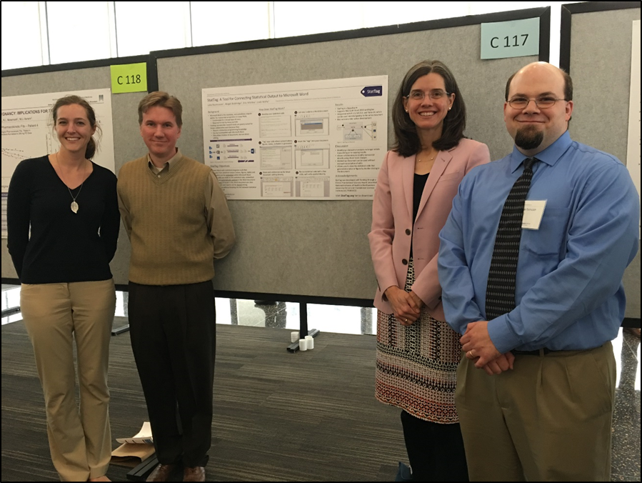
Citations and Acknowledgements
Thank you!
Welty, L.J., Rasmussen, L.V., Baldridge, A.S, and Whitley E. (2016). StatTag. Chicago, Illinois, United States: Galter Health Sciences Library. doi:10.18131/G3K76
StatTag is being developed with funding through a Clinical Translational Sciences Award (CTSA) to Northwestern University.
E-mail: stattag@northwestern.edu
We love feedback and
recommendations!

