Slide 1
Best practices for building Shiny enterprise applications / useR! 2019 Toulouse
Filip Stachura @filipstachura
Notes:
Thank you for an introduction. Next to that I am also a husband and recently became a father :) I hold a double degree in applied mathematics and computer science and I’m the CEO of Appsilon.

Slide 2
OUR SERVICES
Projects delivered
50
Commercial Shiny dashboards
delivered
700
Max no. of concurrent users using our Shiny dashboard
40
Data Science consulting
Business applications of Machine Learning
Satellite data analysis
R & Python programming
World class R-Shiny production solutions
@filipstachura
Notes:
As a company we build and deliver data products for enterprise. Nowadays they typically involve machine learning. More than half of our commercial projects is done with R and our core competency is building decision support systems with Shiny.

Slide 3
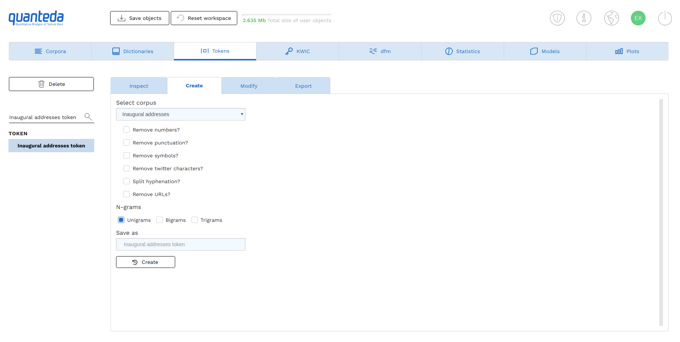
OUR WORK
@filipstachura
@filipstachura
Notes:
Here’s just one example of our work. This is a 100% Shiny application build on top of an amazing R NLP package Quanteda. We build the tool for Ken Bennoit who’s a professor at the LSE.
This application is powerful, but we have build even more advanced applications.

Slide 4
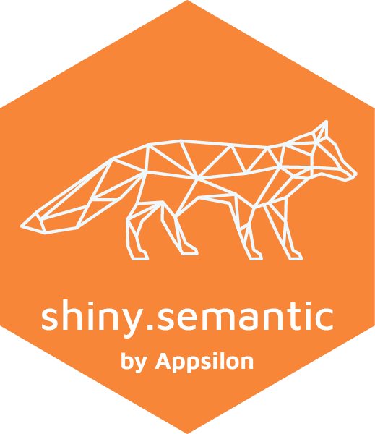
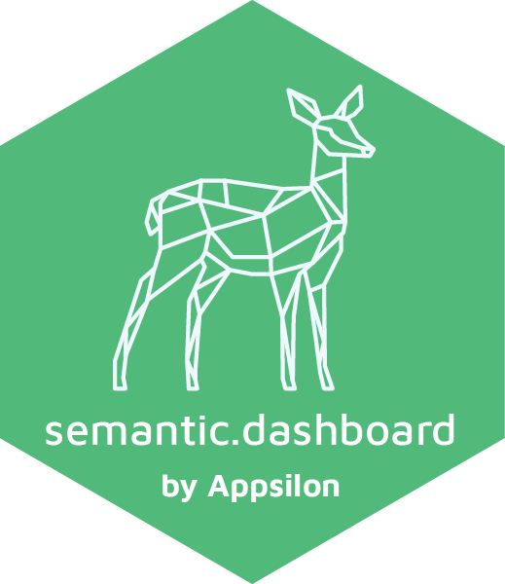
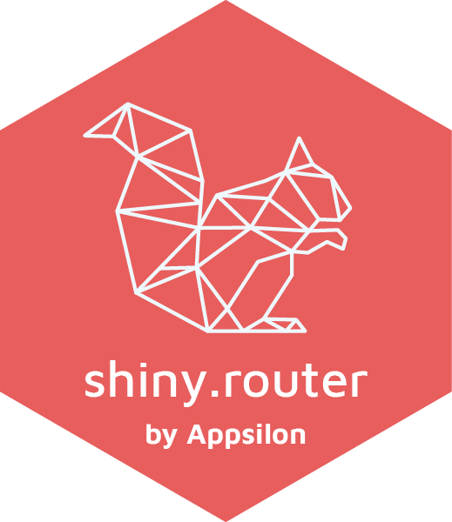
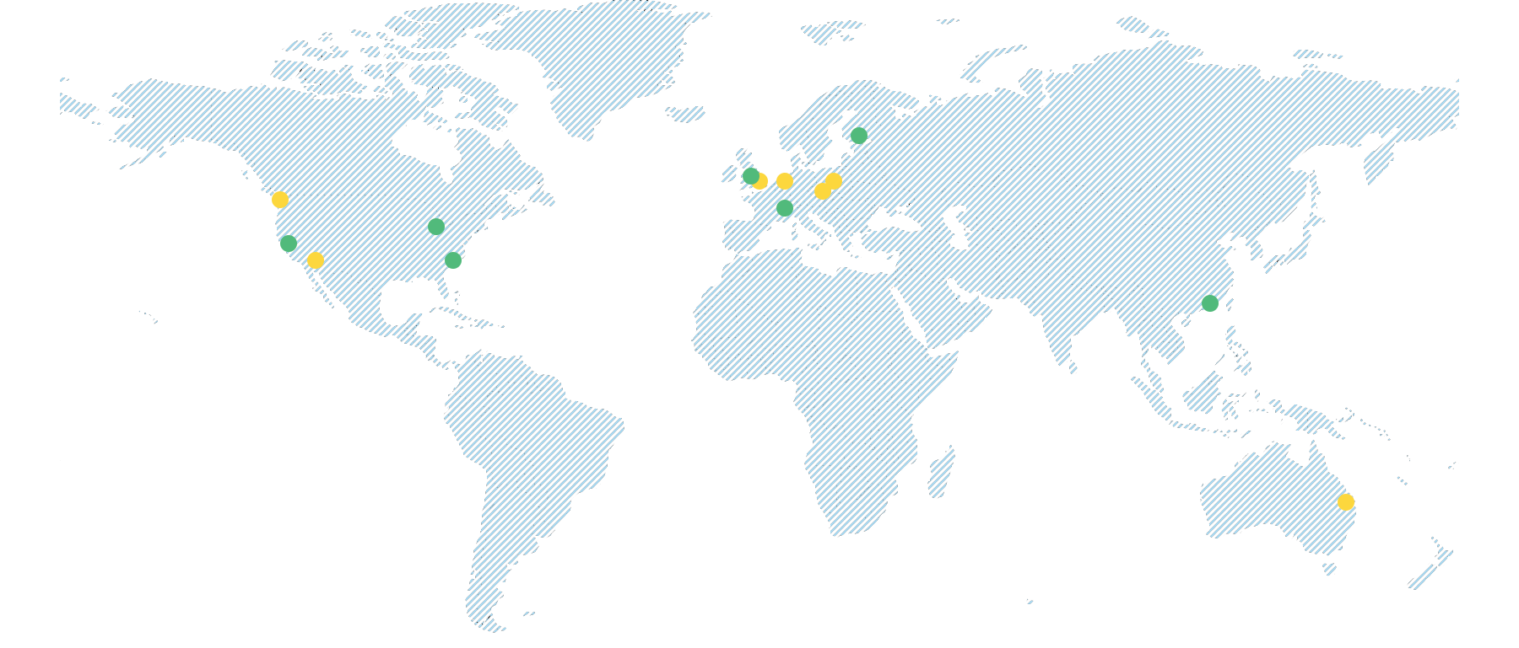
SELECTED CLIENTS
@filipstachura
Notes:
We support our work with our open source packages. I encourage you to try them. Thanks to our experience in both data science and engineering we cooperate with the world’s largest organizations including big financial and pharmaceutical companies, government organizations and NGOs including WHO. Before we jump into lessons learned I want to ask a very important question - why Shiny?

Slide 5
Why ?
@filipstachura
Notes:
This question should be asked for every technology and Shiny is no different here. There is a sweet spot of projects were Shiny is the perfect choice. To find it let’s compare it with other available tools.

Slide 6
WHY SHINY
Django, React, Angular, Go, Scala...
Fast prototyping.
One language.
Clean structure.
Scalability. Correctness.
Excel.
Business Intelligence. Tableau, PowerBi, Qlik
No limitations.
Full power.
@filipstachura
Notes:
Shiny has unmatched speed of development. I remember that the first deal I won with a fortune 500 company. It was thanks too implementing the MVP of the application they asked for in 24 hours. This is something I am not able to do with any other framework or language.
When compared to spreadsheets you get beautiful interface, automation, you can automate anything in the background. You get easy work on shared resources, scalability, reproducibility, and most importantly source code.
Source code is also the main benefit when compared to BI, but next to that you get almost no running fees, full customization and better ML possibilities.
Let say you have a data product to build. If you need more than a spreadsheet or a BI dashboard, but you are not 100% sure of the scope - Shiny is a perfect choice.

Slide 7
6 LESSONS FOR ENTERPRISE SHINY
3
Create a test pyramid.
1
Start with prototype.
2
Build for maintainability and dev velocity.
4
Avoid errors, learn from mistakes.
5
Scale and perform.
6
Automate. Automate fully.
@filipstachura
Notes:
Ok. Let’s dive in. Please imagine you have a Shiny application that you want to build.
We will go through the process of creating it together.

Slide 8
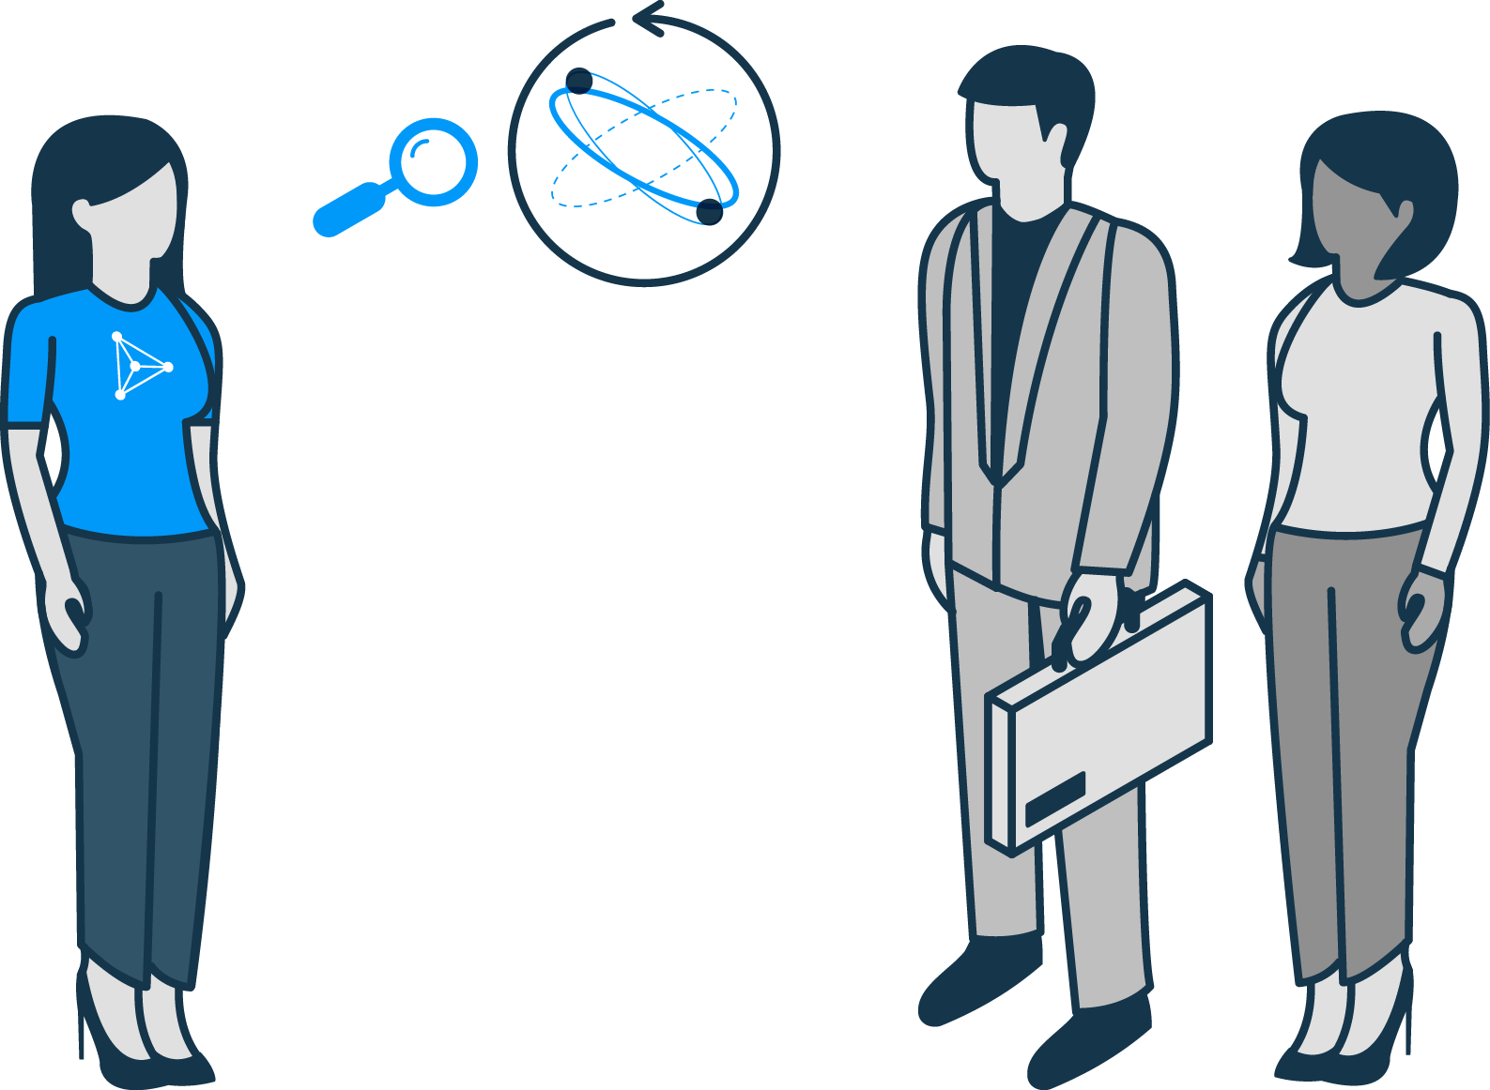
START WITH PROTOTYPE
Customer Development
Buy-in from users
Productionization
@filipstachura
Notes:
The first lesson is the simple one. Don’t overspend. If you have an idea - validate it with the people that are going to use your tool. We need to find a group willing to help us to test it. Once we get to the point they recommend the tool to their peers - we are ready for a full roll out. Anything before that would be premature.

Slide 9
MAINTAINABILITY AND VELOCITY
Traits of a good architecture:
Use of modules.
Logic extracted and tested.
No heavy computations*.
Data loaded from database.
* but avoid premature optimization!
@filipstachura
Notes:
2nd lesson is about the architecture of the app. Good architecture is an art, but when done well it simplifies our lifes by an order of magnitude.
We can use modules to split an app to independent parts. Using Shiny modules is a good start.
Logic of an app should be separated which makes it easier to maintain but also to verify with the tests.
Heavy computations can be extracted as an API or just precalculated if possible.
Data should not be stored in the memory of the server or even worse - each session but loaded from the database when needed.

Slide 10
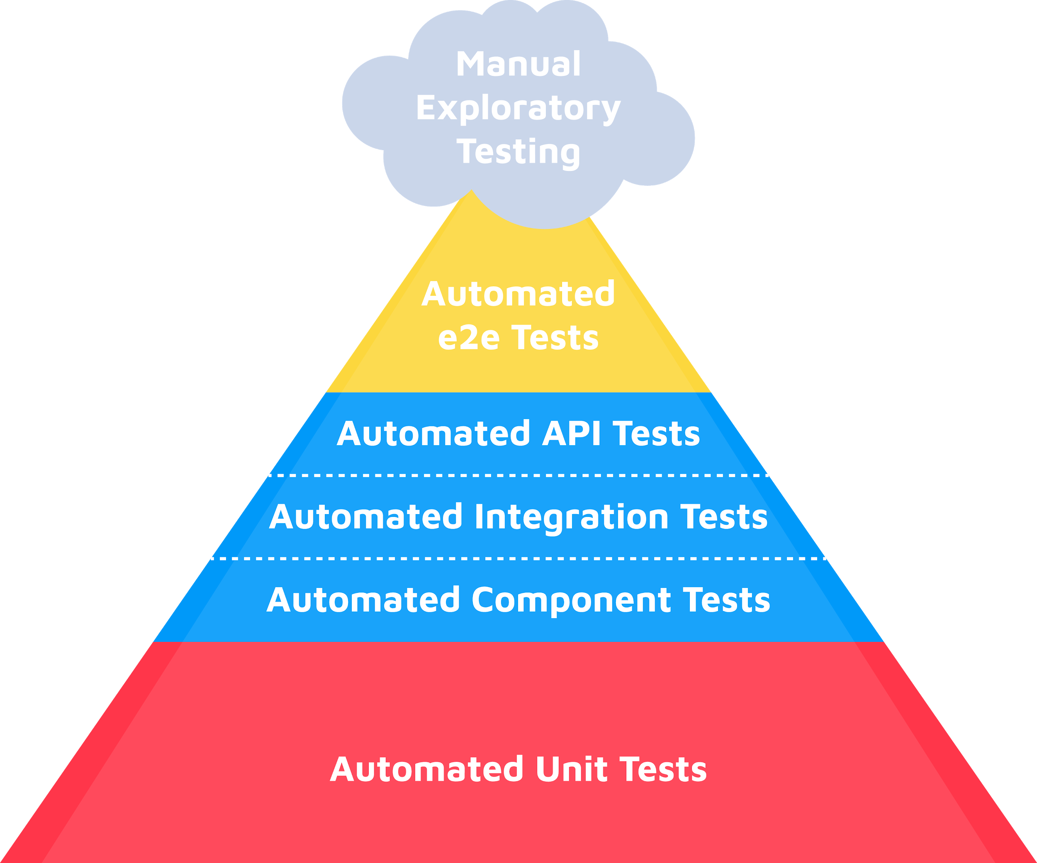
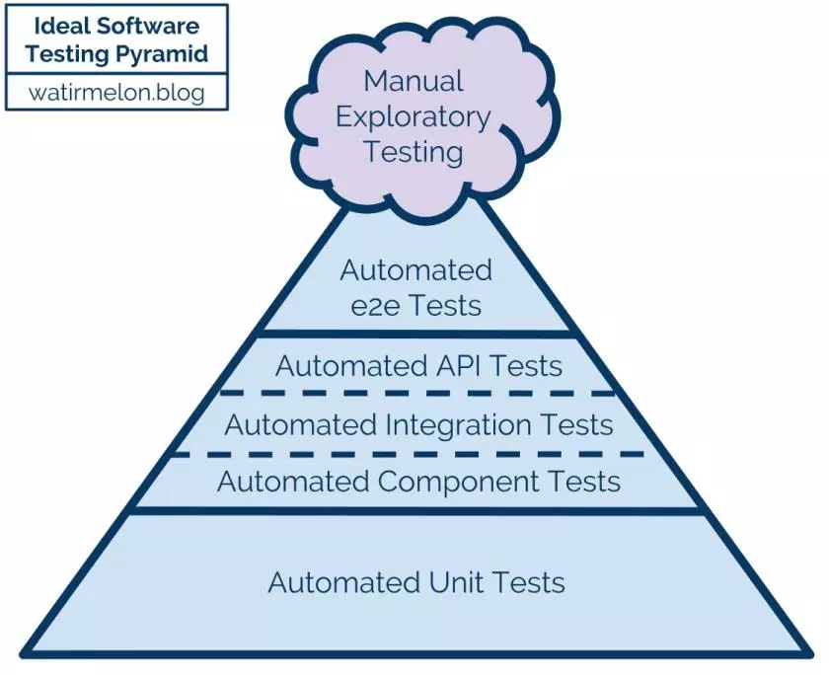
SHINY TEST PYRAMID
Ideal Software Testing Pyramid
Source: https://watirmelon.blog/testing-pyramids/
@filipstachura
Notes:
Lesson three: tests. Many engineers, but also business folks have a love-hate relationship with tests. They love to have them, but they hate to create them.
Writing tests might seem like an overhead, but pays off in the long run. The key is to have just the right mix of tests: we need many simple, unit tests. Than less and less more complex tests. And finally only a few end to end tests. This structure allows to minimize time needed for manual testing.
Sadly, this is not the industry standard for the Shiny apps.

Slide 11
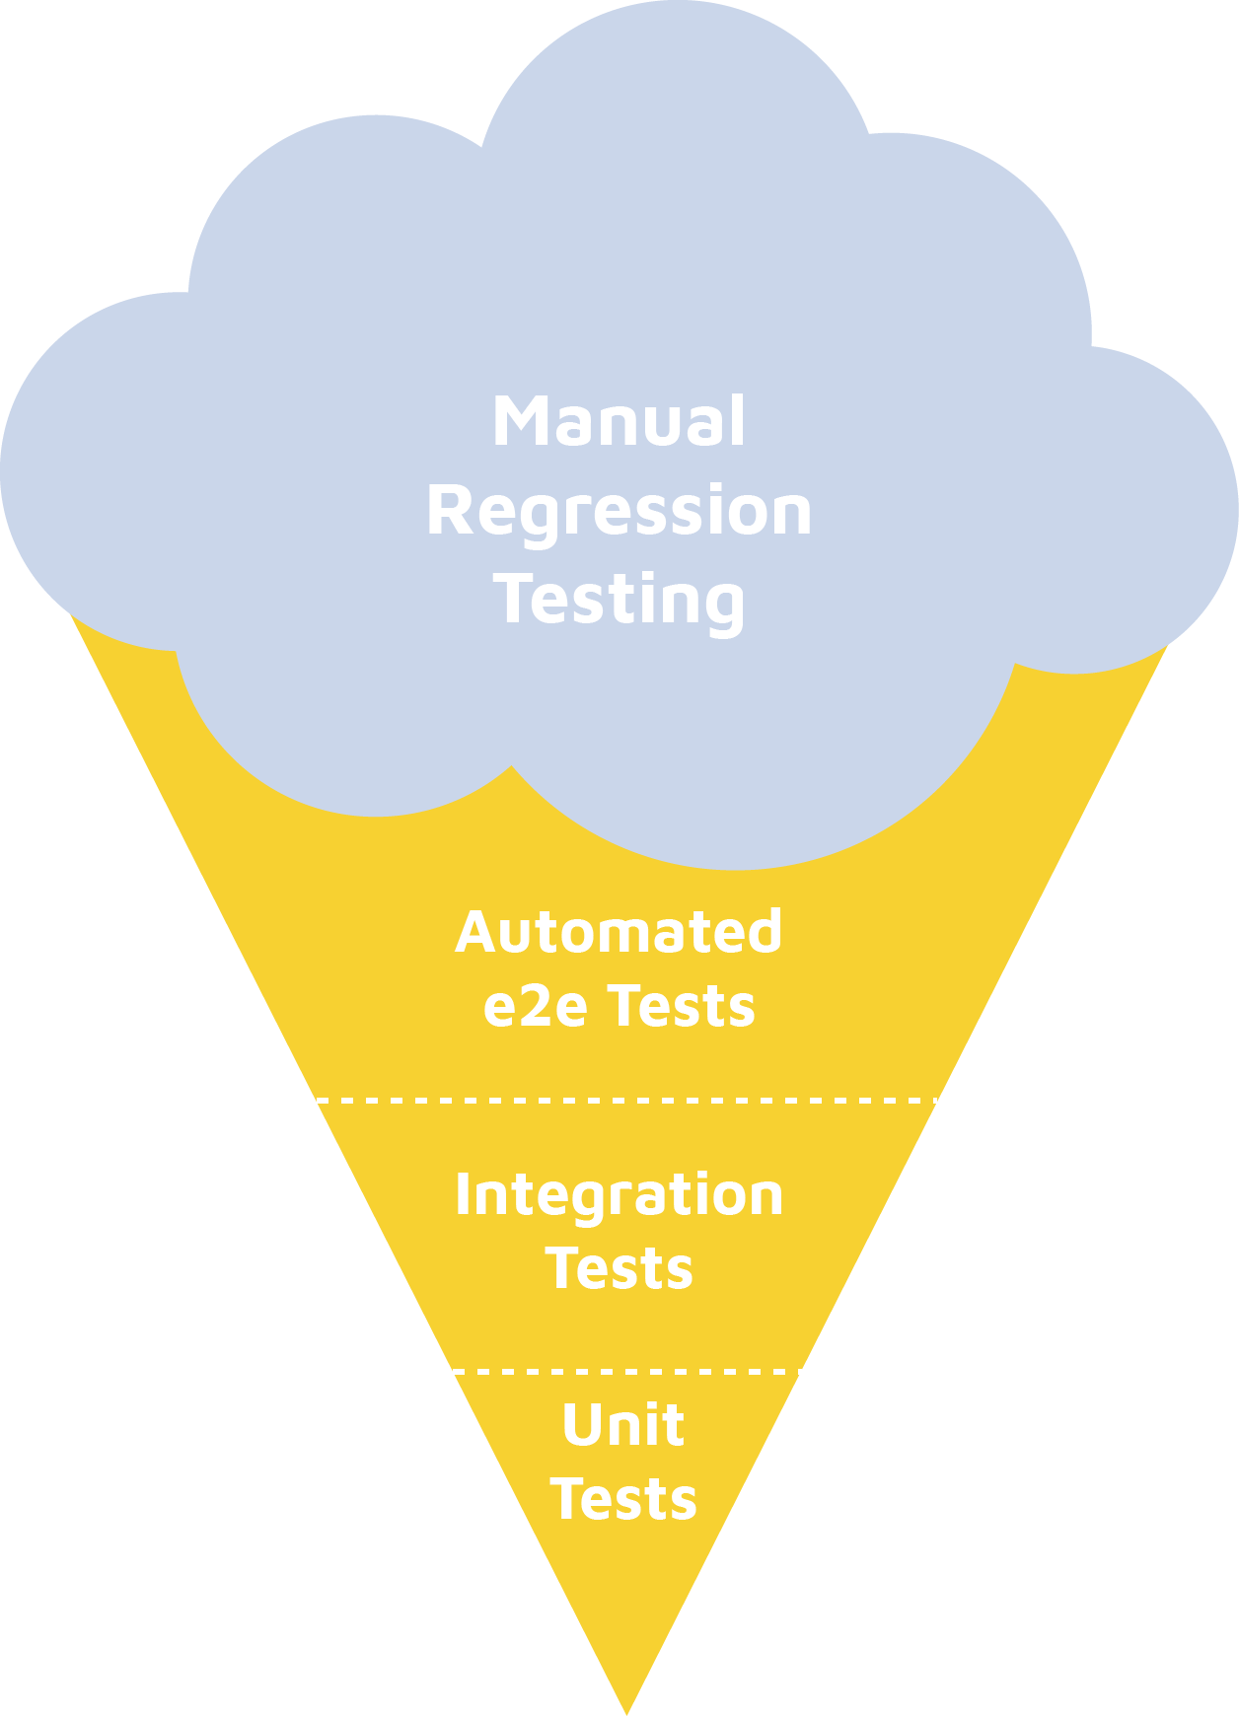
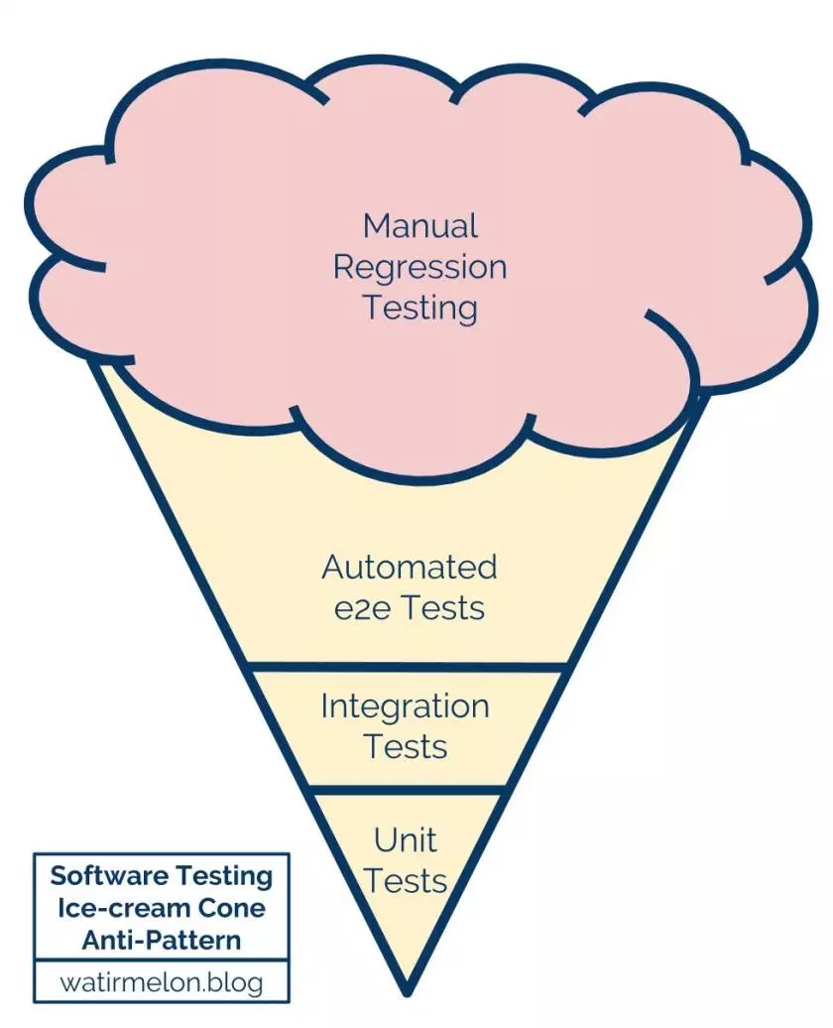
SHINY TEST CONE
Software Testing Ice-cream Cone Anti-Pattern
Source: https://watirmelon.blog/testing-pyramids/
@filipstachura
Notes:
If we see tests at all than most often we see what is called a test cone. Few or none unit tests and a lot of end to end tests. Running end to end tests requires a lot of time so down the road people stop to run them and to write new tests. And not having tests is the easiest way to get bugs.

Slide 12
AVOID ERRORS IN PRODUCTION
Always validate data.
Dataset owner alerts.
Logging infrastructure.
Fault tolerance.
@filipstachura
Notes:
And we want to avoid as many of them as possible. Lesson four is about validating data before running Shiny, this should be done automatically. Each dataset should have an owner if any test fails.
We also need to set up logging infrastructure and make our app useful in case anything goes wrong - for example if the API we use in the app is down. Although this is standard for engineering this is not standard yet for R and Shiny. You don’t want to have business folks go through R errors in the app.

Slide 13
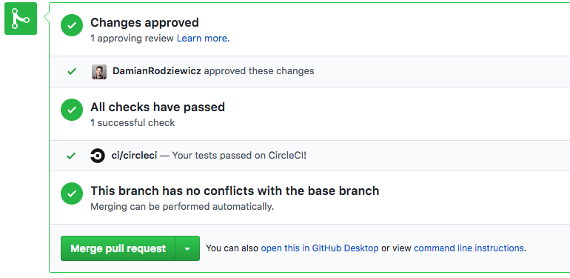
AVOID ERRORS IN PRODUCTION
Daily data validation email
Continuous integration
Style improvement
Show data status in app
@filipstachura
Notes:
To make it easier you can set up data validation emails or send a text with an alert. You set up continuous integration to validate code and style automatically as well. Sometimes it also makes sense to show data status directly to the users.

Slide 14
DATA VALIDATION LEVELS
Data quality is more than structure and format
Read more: appsilon.com/data-quality/
@filipstachura
Notes:
We are quite paranoid about data quality, so here is a quick cheat sheet you can go through to see what kinds of tests there are. And if you want to learn more make sure to check Paweł’s post. If you set up these checks you will avoid many errors in production environment.

Slide 15
SCALING AND PERFORMANCE
1. Load balance:
RStudio Connect
Amazon ELB
2. Profile.
3. Run performance tests.
headless
non-headless
@filipstachura
Notes:
Ok, so our app is up and running. Now you need to scale and keep performance in check. We need to run Shiny in many processes and possibly on many servers and then run performance tests.

Slide 16
EXAMPLE ARCHITECTURE
MASTER NODE
ANSIBLE R
(RESULTS PROCESSING+VIS)
QUERY SERVER₁
QS₂
QS₃
QS_{n}
GOOGLE PUPPETEER
LOAD BALANCER
AWS APPLICATION LOAD BALANCER
APP₁
APP₂
APP_{n}
DB
@filipstachura
Notes:
This is a real example of a deployment architecture. Load balancer is distributing work among applications in RStudio Connect. Master node is performing the test and gathering statistics to summarize them. To make it even more sweet we summarize the test with R as well.

Slide 17
DEPLOYMENT STRATEGIES
1 deployment environment.
2-3 environments: staging,
test, production.
Automated (e.g. ansible, docker)
saves time, easy roll back, one click to drop or create server
Manual.
Avoid static files. Bundle what you can.
Not optimized.
@filipstachura
Notes:
Finally - the last lesson. Deployment and automation. We need more than one environment - you need at least 2 so that developers can test on other server than users are using. Automated deployment pays off very quick and you can magically operate on cloud resources. With it, it’s very easy to roll back or to create another instance of an app in several seconds.

Slide 18
DECISION SUPPORT SYSTEM: WHAT’S BELOW THE SURFACE?
UI & FEATURES
AUTOMATED TESTS
DATA VALIDATION IN ETL
LOAD & PERFORMANCE TESTS
SSO INTEGRATION
AUTOMATED DEPLOYMENT
END-TO-END TESTS
AUTOMATED CODE QUALITY CHECKS
@filipstachura
Notes:
That’s it. Our app is ready, but below the beautiful interface and machine learning model there is a longer list of engineering work that makes the tool ready and usefull for an enterprise. But the good news is that all this is possible and viable with R.

Slide 19
Shiny is ready for production!
Let’s grab a coffee! ☕️
filip@appsilon.com
appsilon.com
Notes:
I hope you’re going to find these lessons useful and that you will be successful in your work. Thank you for your attention and I’d be happy to answer questions now or during the coffee break.

