Slide 1
Deploying machine learning models at scale
Angus Taylor

Slide 2
Introduction
Deploy machine learning:
Put machine learning models into production
Score data and serve the results to users or other systems
Production systems for business applications need to be:
scalable
elastic
available
consistent
Cloud-based architectures meet these requirements

Slide 3
Outline
Docker for R
Architectures for batch inferencing
Architectures for real-time inferencing

Slide 4
Docker for R

Slide 5
Why Docker?
Production applications need to be consistent
consistent R code
consistent R packages
consistent R version
consistent OS dependencies
Production applications need to be portable
transition seamlessly from development to production
run on multiple (virtual) machines

Slide 6
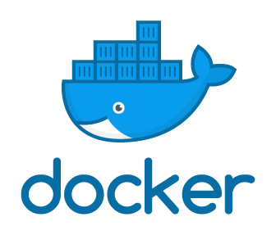
Docker containers
A Docker container encompasses everything needed to run an application
Deploys anywhere that Docker is installed
Development environment matches production
score.R
R installation
R packages
OS kernel
OS dependencies
R models?

Slide 7
Docker concepts
Git repository
Docker Hub /
Azure Container Registry
build
Dockerfile
Docker image
pull
run
VM
VM
VM
Docker containers

Slide 8
Dockerfile
Instructions for building a docker image
Use rocker base images
Install all necessary dependencies
Specify the scoring script to run
FROM rocker/tidyverse:3.5.1
RUN R –e “devtools::install_github(
“Azure/doAzureParallel”)
RUN R install2.r jsonlite dotenv
CMD [“Rscript”, “score.R”]

Slide 9
Package management for R
Recommendations
Packrat package
Snapshot package
MRAN (daily archive of CRAN)
devtools::install_github(“package”, ref = “commit”)
Anaconda
Use these to “pin” package versions in your Dockerfile!

Slide 10
Architectures for batch inferencing

Slide 11
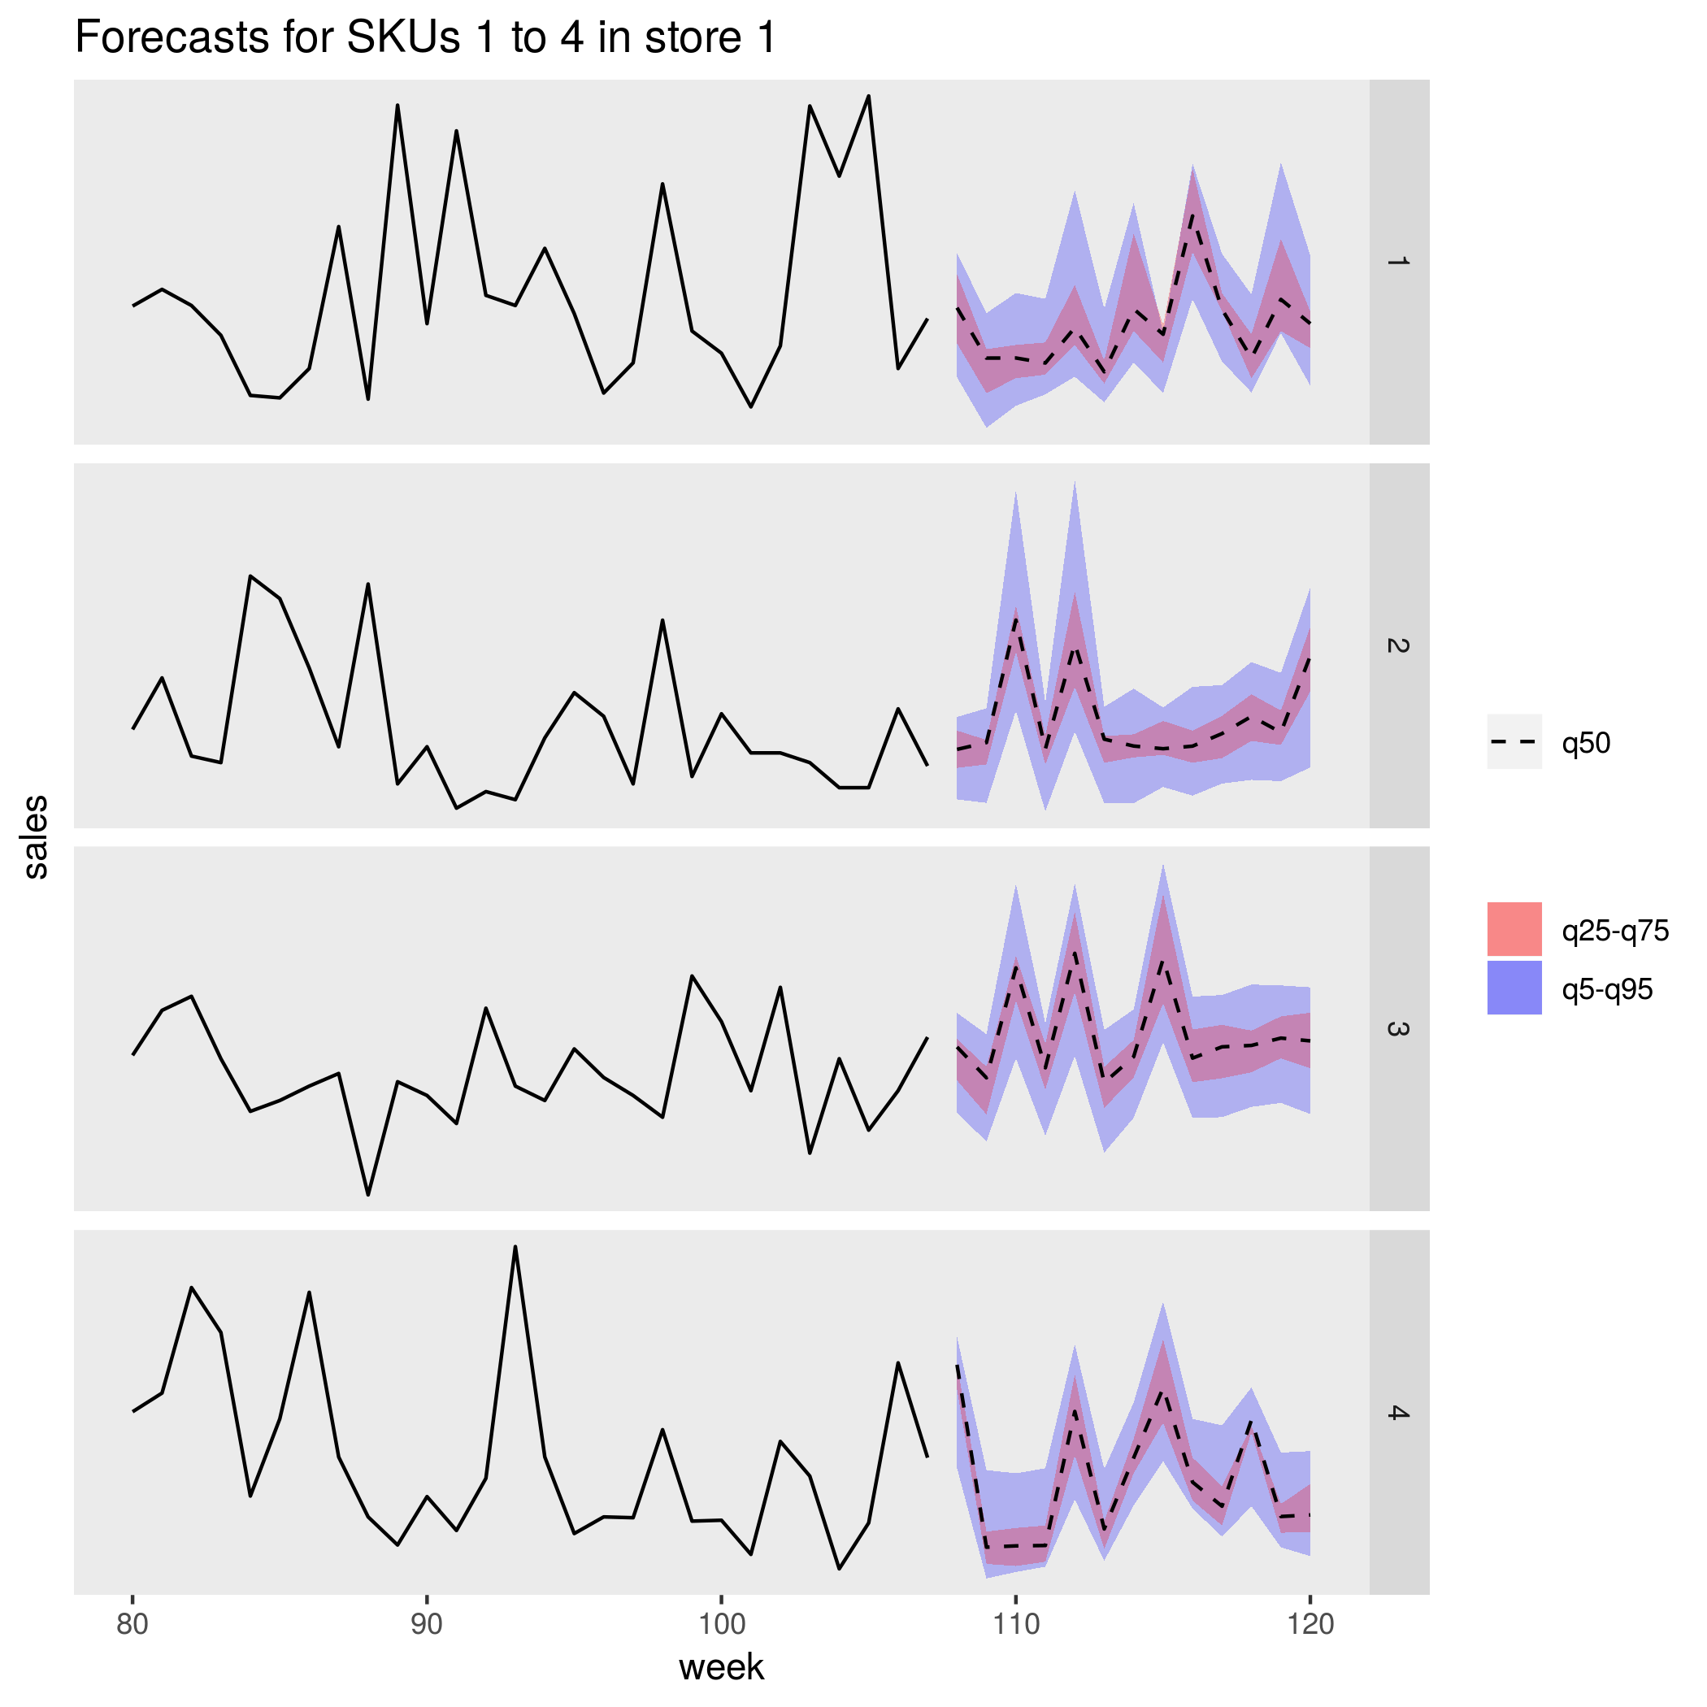
Example use case: product sales forecasting
Forecast sales of 1,000s of products
Produce forecasts on a schedule every week
Size of product range changes over time
Requirements:
Efficiency
Scalability
Cost!

Slide 12
Azure Batch
Cluster of VMs in the cloud
Each VM runs scoring job in a docker container
Only pay while they’re running
Cluster auto-scales

Slide 13
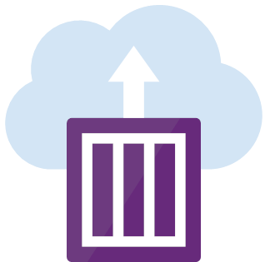
Azure Container Instance
Serverless compute
Runs a docker container
Use as the “master node” to trigger scoring jobs
Use doAzureParallel package within ACI job to trigger scoring jobs on Azure Batch
Only pay for the time it runs

Slide 14
Batch inferencing architecture
Azure Container Registry
Azure Container Instance
triggers parallel scoring jobs
Master image
doAzureParallel
run_jobs.R
Worker image
ML packages
score.R
Azure Batch cluster
runs score.R
Azure blob storage holds data and R models

Slide 15
Architectures for real-time inferencing

Slide 16
Example use case: product recommendation
Provide product recommendations to users of a retail website
Potentially 1,000s of users at any one time
Highly elastic demand
Requirements:
Availability
Latency
Elasticity
Cost!

Slide 17
Azure Kubernetes Service
Highly available containerized deployment
Serves HTTP requests at very low latency
Load balancing for elasticity

Slide 18
Microsoft Machine Learning Server
Host a machine learning model as a web service
Listens for HTTPs requests
Makes predictions with scoring code
Returns response
Alternative: plumber package
library(mrsdeploy)
model <- readRDS("model.rds")
publishService(
“model-service”,
v=“1.0.0”,
code=“score.R”
model=model
)

Slide 19
Real-time inferencing architecture
Ingress controller
for load balancing
Predictions
HTTP response
Input
HTTP request
Data
Predictions
Azure Container Registry
Docker image
Model object
Prediction function
MMLS / plumber

Slide 20
Conclusion
Use Docker to create consistent and portable ML deployments
Use containerized VM clusters for batch inferencing
Use Kubernetes clusters for real-time inferencing

Slide 21
https://github.com/Azure/RealtimeRDeployment
https://github.com/Azure/RBatchScoring

