Slide 1
Simulation of the Physical Movement for Machine Learning with R: Simulation of Robot Gait Optimization Using GA
Hae Yoon Jung, Hyun Sun Cho, Eun-Kyung Lee
Ewha Womans Univ, South Korea
Notes:
Today, I want to talk about simulation of physical movement for machine learning with R, simulation of robot gait optimization. I’m Haeyoon Jung. We study statistics at the Ewha Womans University in South Korea. We were interested in physical simulation while studying calculation algorithms using R. So, we started this project. Before beginning talk, I inform you that we are not physics experts. Then let's get started

Slide 2
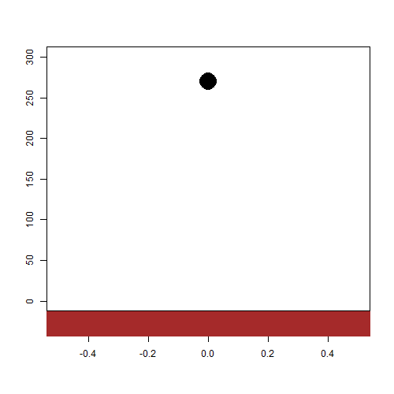
A ball in R
Suppose there is a ball in the coordinate
(x=0, y=260).
When we fix the coordinate in R, the ball stays in that position.
Notes:
Suppose there is a ball. When we fix the coordinate in R, the ball stays in that position.

Slide 3
A ball in REAL WORLD (EARTH)
But on Earth, the ball cannot be fixed in the air. Because of gravity, the ball falls down and bounces to the ground.
This is a simple form of physical simulation which creates the Earth-like environment in a computer.
Notes:
But on Earth, the ball cannot be fixed in the air. Because of gravity, the ball falls down and bounces to the ground. This is a simple form of physical simulation.

Slide 4
Importance of physical simulation
The possibilities can be assessed before the product is produced.
It can reduce trial and error when producing a product.
It can prevent accidents by simulating in advance.
<<popular software>>
Why R?
Most popular , but It’s not free
Based on Ubuntu.
→ difficult to install in windows
free
open source (many packages)
→ Easy to apply many Machine learning algorithms
Notes:
Physical simulations are very useful in industry terms.
There are a lot of software for physical simulations. However, R is free and open source. It’s easy to apply many machine learning algorithms. So, we made environment in R.

Slide 5
Physical simulation environment setup
Ordinary physical simulation environment
Any object is possible.
Our physical simulation environment
Only for our robot
Position of center of mass
& trajectory of gait
Position of Center of mass
Position of feet
Automatic
Calculate force
Solve dynamic equation
Notes:
In the ordinary environment, any object is possible. Unfortunately, our environment is only for our robot.

Slide 6
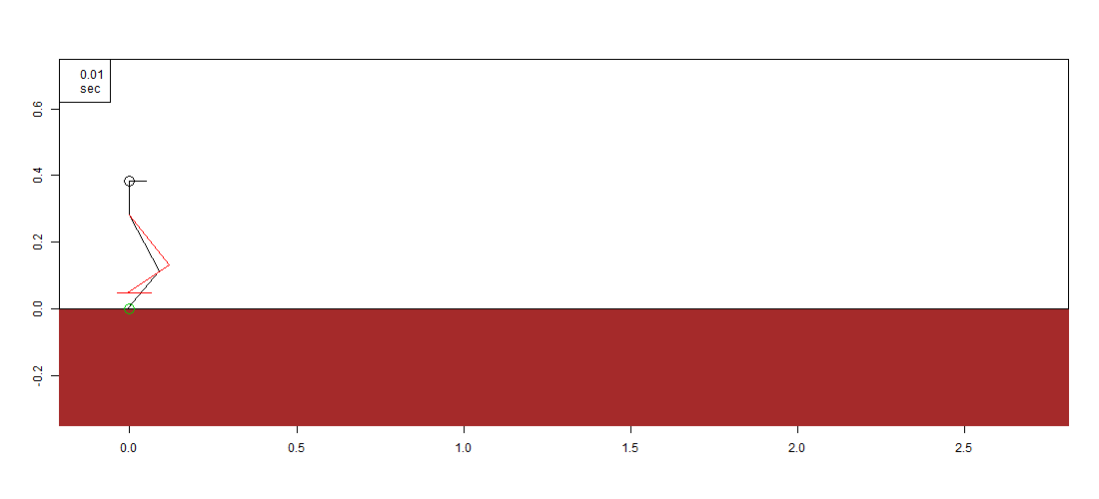
We made a robot simulation that walked by inputting gait parameters, as shown below. So I will explain how we created a physical simulation and optimized gait parameters in this talk.
T (gait cycle period) =1.220, s (gait width) =0.283, H(gait height)=0.05, h(pelvis height)=0.28, bias (gait-x bias) =-0.006
Notes:
We made a robot simulation that walked by inputting gait parameters. I will explain how we created a physical simulation and optimized gait parameters in this talk. (!!break!!)

Slide 7
Contents
1. Design physical simulation
Background Knowledge
Parameter selection and assumption
Algorithm
2. Optimize gait parameters
GA(Genetic Algorithm)
Applying GA
Notes:
This is the table of contents.
Part1 is about designing physical simulation. In this part, I’ll talk about background knowledge and parameter selection and assumption, and also simulation algorithm
Part2 is about optimizing gait parameters. In this part, I’ll talk about what is GA and applying GA

Slide 8
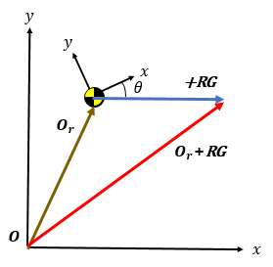
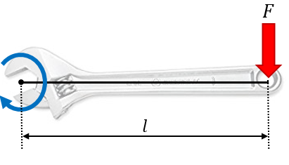
1-1) Background Knowledge
1. Geometry and Vector
Conversion to two-dimensional coordinates is required
Rotation matrix
To get the coordinates of the feet that change as the angle of sight changes.
2. trigonometric formula
→ To find the position of the knee in the animation
R=$\left(\begin{matrix}cosθ & −sinθ \\ sinθ & cosθ\end{matrix}\right)$
2. Dynamics
Static mechanics: Action and reaction form the equilibrium of force. (The object stops.)
Dynamics mechanics : The balance of power has not been achieved.
- Moment(Torque): rotating force. ($τ=l(length)×F$(force))
Notes:
There are three background knowledges required before designing a simulation. First is geometry and vector to present the robot in two dimensions. Second is dynamics to solve force acting on the robot.

Slide 9
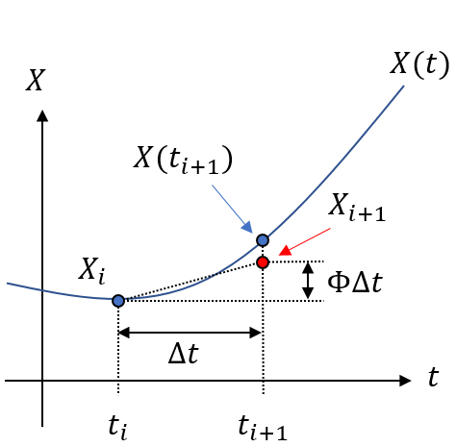
1-1) Background Knowledge
3. 3rd Runge–Kutta method
This method is a kind of numerical integral. If we know the force($\sum{F}$), we can know the acceleration($a=\frac{\sum{F}}{m}$). If we Integrate acceleration twice, we can get position of mass. The following positions of robot can be identified by using the 3rd Runge-Kutta method.
$$\sum{F}=ma\left(mass×\text{a}\text{cceleratio}n\right), a=\frac{\sum{F}}{m}$$
$$\frac{x}{dt}=\dot{x} (velocity), \frac{\dot{x}}{dt}=\ddot{x} (\text{a}\text{cceleratio}n)$$
3rd Runge–Kutta method
$X_{i+1}=$ $X_{i}+\frac{1}{6}\left(k_{1}+4k_{2}+k_{3}\right)∆t$ , $(t_{i+1}=∆t+t_{i})$
$k_{1}=f\left(t_{i},X_{i}\right)$ , $k_{2}$=$f\left(t_{i}+\frac{∆t}{2},X_{i}+\frac{∆t}{2}k_{1}\right)$, $k_{3}$=$f\left(t_{i}+∆t,X_{i}−∆tk_{1}+2k_{2}∆t\right)$
$${\dot{X}}_{i}=f\left(t_{i},X_{i}\right)$$
$$\left[\begin{matrix}\dot{x} \\ \ddot{x}\end{matrix}\right]=\left[\begin{matrix}0 & 1 \\ 0 & 0\end{matrix}\right]\left[\begin{matrix}x \\ \dot{x}\end{matrix}\right]+\left[\begin{matrix}0 \\ 1/m\end{matrix}\right]F$$
Notes:
Third is Runge-Kutta method. It’s a kind of numerical integral. If we know the force, we can know the acceleration. Integrating acceleration twice is the position of mass. The following positions of robot can be identified by using the 3rd Runge-Kutta method.

Slide 10
1-1) Background Knowledge
Runge-Kutta induction
3rd Runge-Kutta method is induced by the 3rd Taylor series.
taylor series(3rd)
$X_{i+1}$=$X$($t_{i}+∆t)≈c_{0}+c_{1}∆t+c_{2}{∆t}^{2}+c_{3}{∆t}^{3}$
$c_{0}= X$($t_{i})$, $c_{1}=\frac{d}{dt}X\left(t\right)|_{t=t_{i}}=f(t_{i},X$($t_{i}))$ , $c_{2}=\frac{d^{2}}{dt^{2}}X\left(t\right)|_{t=t_{i}}$, $c_{3}=\frac{d^{3}}{dt^{3}}X\left(t\right)|_{t=t_{i}}$
3rd Runge–Kutta method
$X_{i+1}=X_{i}+\int_{t_{i}}^{t_{i+1}}{\dot{X}}dt$ =$X$($t_{i})+\int_{t_{i}}^{∆t+t_{i}}{\dot{X}}dt=$ $X$($t_{i})+\frac{1}{6}\left(k_{1}+4k_{2}+k_{3}\right)∆t$ , $(t_{i+1}=∆t+t_{i})$
$k_{1}=f\left(t_{i},X_{i}\right)=f(t_{i},X$($t_{i}))$ , $k_{2}$=$f\left(t_{i}+\frac{∆t}{2},X(t_{i})+\frac{∆t}{2}k_{1}\right)$, $k_{3}$=$f\left(t_{i}+∆t,X(t_{i})−∆tk_{1}+2k_{2}∆t\right)$
Notes:
As we pressed for time, I would like to skip the detailed.

Slide 11
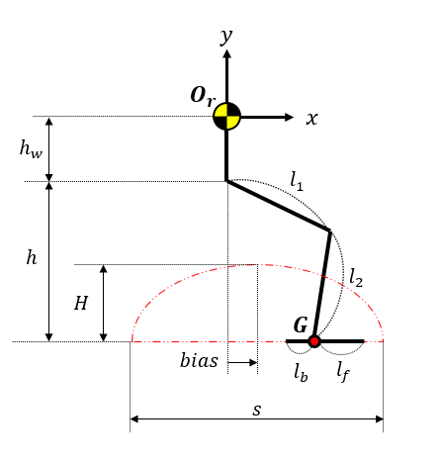
1-2) Parametric Selection and Assumption
Parameter - parameters determine the trajectory of feet
T(gait cycle period) : Time taken in one cycle
s(gait width)
H(gait height)
h(pelvis height)
bias(gait-x bias) : The difference between the x-value of the pelvis and the x-value of center of the foot.
Setting – dimensions of robot
Head weight : 1kg
Gravity acceleration : 9.81m / s²
Upper leg : 0.19m$\left(l_{1}\right)$
Lower leg: 0.15m$(l_{2})$
length from ankle(G) to toe: 0.07m($l_{f}$)
length from ankle(G) to heel : 0.03m($l_{b}$)
Notes:
The following is about parameters and settings of robot.
There are 6 settings. They are dimensions of robot.

Slide 12
1-2) Parametric Selection and Assumption
$$y$$
Assumption
The weight of any part except head is assumed to be negligible. Therefore inertia and air resistance can be ignored and center of mass is always the head.
Of course the feet are made up of lines(soles) in 2-dimensional. But for the convenience of physical calculation, we assumed that each foot is made up of two points(toe, heel).
$$O_{r}$$
$$x$$
Notes:
And we made two assumptions for the convenience of physical calculation.
First, the weight of any part except head are negligible. So, the center of mass is always the head.
Second, each foot is made up of two points, toe and heel not soles.

Slide 13
Foot movement (center of foot)
We assumed that the robot’s gait cycle (trajectory) is as follows. It represents center of the foot's coordinate system
Right foot
Left foot
Starting
point
$$G_{y}=Hcos⁡(\frac{π}{s}G_{x})$$
$$y$$
$$G_{y}=Hcos⁡(\frac{π}{s}G_{x})$$
$$y$$
$$G$$
$$G$$
$$Starting$$
point
$$O_{g}$$
$$x$$
$$x$$
$$O_{g}$$
$$G_{x}=\frac{s}{2}sin⁡(\frac{2π}{T}t)$$
$$G_{x}=\frac{s}{2}sin⁡(\frac{2π}{T}t+π)$$
$O_{g}$(bias,-h-hw) is Origin point
Notes:
Assumed robot’s gait cycle is as follows.

Slide 14
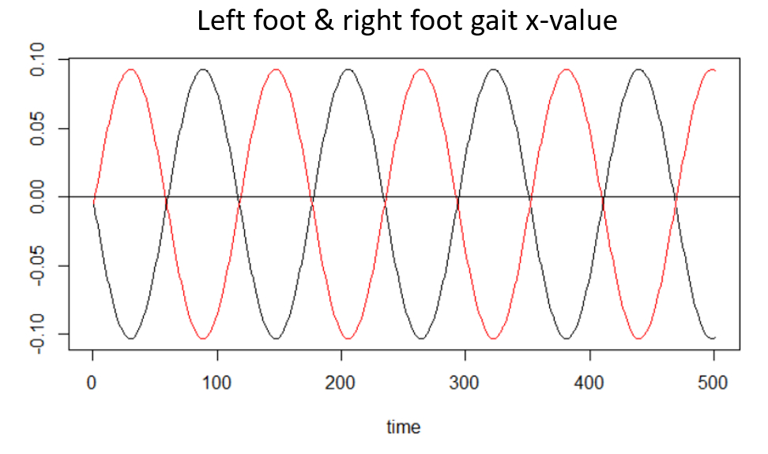
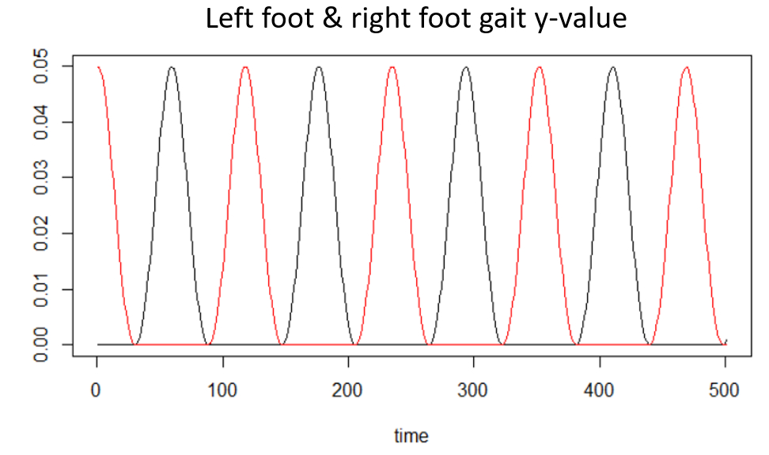
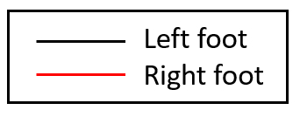
Foot movement (center of foot)
Two graphs show the center position of foot coordinates over time. x-value and y-value of the left foot and right foot intersect perfectly.
Notes:
Two graphs show the center position of foot coordinates over time. x-value and y-value of the left foot and right foot intersect perfectly.

Slide 15
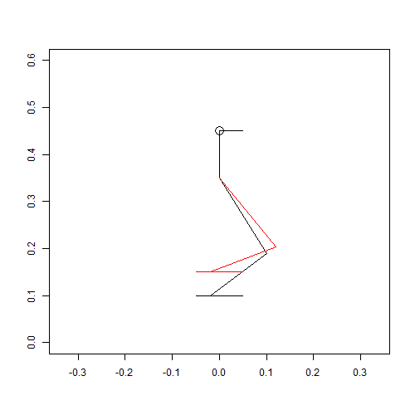
Foot movement
We can look at the movement of the foot when the position of mass is fixed through the animation. The soles of the feet were constructed parallel to the angle of sight.
Notes:
We can look at the movement of the foot. The soles of the feet were constructed parallel to the angle of sight.

Slide 16
1-3) Algorithm
Get position of feet
I mentioned the robot's settings and the trajectory of gait, and now I'm going to introduce to create a walking algorithm for the robot.
How many points touch
The ground?
Obtain force
according the case
Save the position at i^{th} time
Position & Velocity constraint
Numerical integration to obtain
following position of mass
Get postion of robot
Robot falls down and stops
Notes:
I mentioned the robot's settings and the trajectory of gait. And now I'm going to introduce to create a walking algorithm for the robot.

Slide 17
1-3) Algorithm
According to the previous foot movement, at least one foot (sole) at every moment touches the ground completely. However, as the robot moves, it generates rotational force (moment), so the angle of sight is not always zero.
Get position of feet
How many points touch
The ground?
Obtain force
according the case
Save the position at i^{th} time
Position & Velocity constraint
Numerical integration to obtain
following position of mass
Get postion of robots
Robot falls down and stops
Notes:
As the robot moves, it generates rotational force, so the angle of sight is not always zero

Slide 18
Center of foot points
We mentioned the trajectory of foot. As the robot moves, the angle of sight changes and the positions of the feet change accordingly. The center of foot point vector is shown as follows by the rotation matrix.
$$y$$
$$y$$
$θ$ is angle of sight
$$O_{r}$$
$$x$$
$$x$$
$$O_{r}$$
$$θ$$
Center of left foot point vector: $O_{r}$+R*GL
Center of right point vector: $O_{r}$+R*GR
GL
R*GL
GR
R*GR
$$y$$
R =$\left(\begin{matrix}cosθ & −sinθ \\ sinθ & cosθ\end{matrix}\right)$ is the rotation matrix
$$y$$
$$θ$$
$$O$$
$$x$$
$$O$$
$$x$$
$$θ$$
Notes:
We mentioned the trajectory of foot. As the robot moves, the angle of sight changes. And, the positions of the feet change accordingly. This is the center of foot point vector.
And this is rotation matrix. Theta is angle of sight.

Slide 19
Foot tip points
The coordinates of the toes and heels also vary with the angle of sight using a rotation matrix. The principle is as follows.
$$y$$
$$x$$
$$O_{r}$$
$$θ$$
Left foot toe point vector: $O_{r}$+R* GL + R*lf
Left foot heel point vector: $O_{r}$+R* GL + R*lb
Right foot toe point vector: $O_{r}$+R* GR + R*lf
Right foot heel point vector: $O_{r}$+R* GR + R*lb
R* GL
R*dR
R*lf
$$y$$
R*lb
$$θ$$
R*lf
R =$\left(\begin{matrix}cosθ & −sinθ \\ sinθ & cosθ\end{matrix}\right)$ is rotation matrix
$$O$$
$$x$$
R*lb
$$θ$$
lf=0.07, lb=-0.03
Notes:
And, this is the toes and heel point vector.

Slide 20
1-3) Algorithm
Get position of feet
Now, we know the coordinates of the feet. We can see how many points touch the ground.
How many points touch
The ground?
Obtain force
according the case
Save the position at i^{th} time
Position & Velocity constraint
Numerical integration to obtain
following position of mass
Get postion of robots
Robot falls down and stops
Notes:
Now, we know the coordinates of the feet. We can see how many points touch the ground.

Slide 21
How many points touch the ground?
Below is the number of cases a robot can have.
no point touched
1 point touched
2 points touched
(same foot)
2 points touched
(different feet)
$$y$$
$$O_{r}$$
$$y$$
$$y$$
$$x$$
$$y$$
$$x$$
$$O_{r}$$
$$x$$
$$x$$
$$y$$
$$y$$
$$y$$
$$y$$
$$x$$
$$O$$
$$x$$
$$O$$
$$x$$
$$O$$
$$x$$
Notes:
In this case, no point touch the ground. In this case 1 point touch the ground, In this case 2 points touch the ground and they are same foot.
In this case 2 points touch the ground and they are different feet

Slide 22
How many points touch the ground?
Below is the number of cases a robot can have.
3 points touched
4 points touched
$$y$$
$$y$$
$$O_{r}$$
$$O_{r}$$
$$x$$
$$x$$
$$y$$
$$y$$
$$O$$
$$x$$
$$O$$
$$x$$
Notes:
In this case 3 points touch the ground. In this case 4 points touch the ground.

Slide 23
1-3) Algorithm
Get position of feet
Now, let’s solve the force of the cases that a robot can have.
How many points touch
The ground?
Obtain force
according the case
Save the position at i^{th} time
Position & Velocity constraint
Numerical integration to obtain
following position of mass
Get postion of robots
Robot falls down and stops
Notes:
Now, let’s solve the force of the cases that a robot can have

Slide 24
The forces we considered are four below. Based on these forces, we solved the forces acting on robots according the case.
force acting on x-axis
- friction force(f ) : force that interferes with the motion of an object between the two contact surfaces of an object.
force acting on y-axis
gravity force(-mg) : force that pulls an object from the ground to the earth.
normal force(N) : force acting perpendicular to an object on the surface. This force prevents objects from digging in the ground.
force acting on angle
- moment($τ$): force to turn an object(rotational force)
$$y$$
$$x$$
$$O_{r}$$
$$θ$$
-mg
$$y$$
f
$$O$$
$$x$$
$$τ$$
N
Notes:
The forces we considered are friction force, gravity force, normal force, moment. Based on these forces, we solved the forces acting on robots according the case.

Slide 25
no point touched
$$y$$
If the robot doesn’t touch the ground, only gravity acts.
$$O_{r}$$
$$x$$
-mg
$F_{x}$= $0$
$F_{y}$= $−mg$
Total Force:
$F_{τ}$= $0$
$$y$$
$$x$$
Notes:
If the robot doesn’t touch the ground, only gravity acts.

Slide 26
The force when one point touches the ground is as follows.
1 point touched
$$y$$
$\sum{F}$ =$\left(\begin{matrix}F_{x} \\ F_{y}\end{matrix}\right)=\left(\begin{matrix}0 \\ −mg\end{matrix}\right)+\left(\begin{matrix}0 \\ N\end{matrix}\right)+\left(\begin{matrix}f \\ 0\end{matrix}\right)=\left(\begin{matrix}f \\ −mg+N\end{matrix}\right)$
→force acting on x-axis
→force acting on y-axis
$$x$$
$$O_{r}$$
$$θ$$
=$ma=−mR\ddot{G}\text{=} m\left(\begin{matrix}\ddot{x} \\ \ddot{y}\end{matrix}\right)$
Twice differential
$O_{r}$+R* Gb+ R*lb
-mg
moment: $τ=d_{x}×m\left(g−\ddot{y}\right)−d_{y}×m\ddot{x}=m(d_{x}\left(g−\ddot{y}\right)−d_{y}\ddot{x})$
$$y$$
→force acting on angle
f
$$O$$
$$x$$
$$θ$$
$F_{x}$= $m\ddot{x}$
$F_{y}$= $m\ddot{y}$
Total Force:
$F_{τ}$= $m(d_{x}\left(g−\ddot{y}\right)−d_{y}\ddot{x})$
N
Notes:
The force when one point touched is as follows.
Force acting on x-axis is friction force, force acting on y-axis is sum of gravity force and normal force. Force acting on angle is moment which is rotational force. It's a bit difficult to solve.

Slide 27
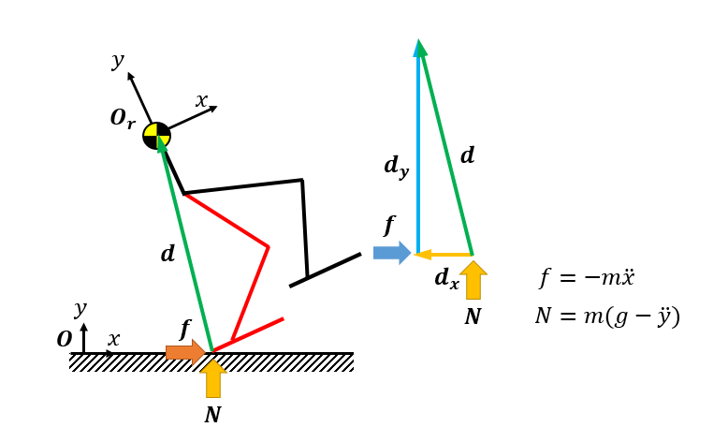
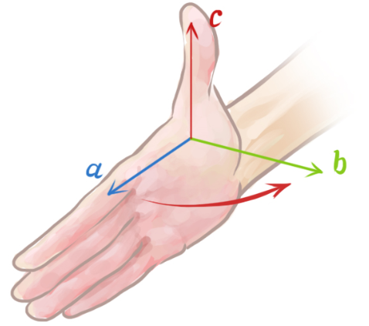
Divide the vector of the point touched the ground to center of mass into x and y axes. Then, multiply the normal force and the friction force respectively.
moment: $τ=d_{x}×m\left(g−\ddot{y}\right)−d_{y}×m\ddot{x}=m(d_{x}\left(g−\ddot{y}\right)−d_{y}\ddot{x})$
→force acting on angle
$$τ$$
Moment is obtained by the law of the right hand.
f
d
$F_{x}$= $m\ddot{x}$
$F_{y}$= $m\ddot{y}$
Total Force:
$F_{τ}$= $m(d_{x}\left(g−\ddot{y}\right)−d_{y}\ddot{x})$
Notes:
We can solve it by recalling the law of the right hand

Slide 28
Force acting on x-axis, y-axis are the same if 1 point touches or 2 points touch the ground.
Force acting on x-axis, y-axis are the same if 1 point touches or 2 points touch the ground.
2 points touched
(same foot)
2 points touched
(same foot)
$\sum{F}$ =$\left(\begin{matrix}F_{x} \\ F_{y}\end{matrix}\right)=\left(\begin{matrix}0 \\ −mg\end{matrix}\right)+\left(\begin{matrix}0 \\ N\end{matrix}\right)+\left(\begin{matrix}f \\ 0\end{matrix}\right)=\left(\begin{matrix}f \\ −mg+N\end{matrix}\right)$
$\sum{F}$ =$\left(\begin{matrix}F_{x} \\ F_{y}\end{matrix}\right)=\left(\begin{matrix}0 \\ −mg\end{matrix}\right)+\left(\begin{matrix}0 \\ N\end{matrix}\right)+\left(\begin{matrix}f \\ 0\end{matrix}\right)=\left(\begin{matrix}f \\ −mg+N\end{matrix}\right)$
→force acting on x-axis
→force acting on y-axis
→force acting on x-axis
→force acting on y-axis
$$y$$
$$y$$
=$ma=−mR\ddot{G}\text{=}m(\begin{matrix}\ddot{x} \\ \ddot{y}\end{matrix})$
=$ma=−mR\ddot{G}\text{=}m(\begin{matrix}\ddot{x} \\ \ddot{y}\end{matrix})$
$O_{r}$+R* Gb+ R*lb
Twice differential
$O_{r}$+R* Gb+ R*lb
Twice differential
$$x$$
$$x$$
It is difficult to calculate each normal force when two points of same foot touch ground. Because two points don’t have exact same normal force. Therefore, We used zmp(zero moment point).
If x- value of zmp is between the heel and the toe, zmp is satisfied.
It is difficult to calculate each normal force when two points of same foot touch ground. Because two points don’t have exact same normal force. Therefore, We used zmp(zero moment point).
If x- value of zmp is between the heel and the toe, zmp is satisfied.
-mg
-mg
If zmp satisfied, robot’s moment($F_{τ}$) is zero.(very stable situation)
If zmp not satisfied, assume that a center of foot point is touched.
(1 point touched)
$$y$$
If zmp satisfied, robot’s moment($F_{τ}$) is zero.(very stable situation)
If zmp not satisfied, assume that a center of foot point is only touched.
(1 point touched)
$$y$$
f
f
If zmp not satisfied, assume that a center of foot point is only touched.
(1points touched)
$$x$$
$$O$$
$$x$$
$$O$$
$F_{x}$= $m\ddot{x}$
$F_{y}$= $m\ddot{y}$
$F_{x}$= $m\ddot{x}$
$F_{y}$= $m\ddot{y}$
Total Force:
Total Force:
$$N_{b}$$
$$N_{f}$$
$$N$$
0 (if zmp satisfied)
$F_{τ}$=
0 (if zmp satisfied)
$$m(d_{x}\left(g−\ddot{y}\right)−d_{y}\ddot{x})(if zmp not satisfied)$$
$F_{τ}$=
$$m(d_{x}\left(g−\ddot{y}\right)−d_{y}\ddot{x})(if zmp not satisfied)$$
28
Notes:
Forces acting on x and y-axis are the same if 1 point or 2 points touched. But, it is difficult to calculate normal force in this case. Because two points don’t have exact same normal force. Therefore, we used zero moment point. If zmp satisfied, moment($F_{τ}$) is zero. If it’s not satisfied, assume that a center of foot point is only touched.

Slide 29
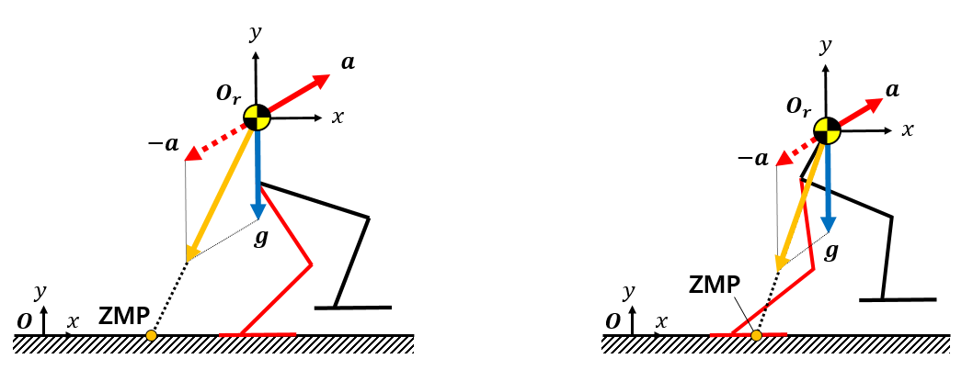
If this formula is satisfied, moment is 0.
${\sum{τ}=−N}_{b }(dx+l_{b}) {−N}_{f }(dx+l_{f})$+$dyf$ =0
($dx+l_{b}$)$N_{b}$+$( dx$+$l_{f}) N_{f}=dyf$
$l_{f} N_{f}+l_{b} N_{b}+dx\left(N_{f}+N_{b}\right)=l_{f} N_{f}+l_{b} N_{b}+dx\left(m\left(g−\ddot{y}\right)\right)= dyf$
$l_{f} N_{f}+l_{b} N_{b}$=$dx\left(m\left(−g+\ddot{y}\right)\right)+ dyf$ (f i$s friction force(−m\ddot{x)}$)
Zero
Moment
Point
$\begin{matrix}N_{f} \\ N_{b}\end{matrix}={\left[\begin{matrix}l_{f} & l_{b} \\ 1 & 1\end{matrix}\right]}^{−1}\left[\begin{matrix}m(dx\left(\ddot{y}−g\right)−dy\ddot{x}) \\ −m(g−\ddot{y})\end{matrix}\right]$=${\left[\begin{matrix}l_{f} & l_{b} \\ 1 & 1\end{matrix}\right]}^{−1}\left[\begin{matrix}k1 \\ k2\end{matrix}\right]$ =$\frac{1}{l_{f}−l_{b}}\left[\begin{matrix} k1−l_{b}k2 \\ −k1+l_{f}k2\end{matrix}\right]$
$$l_{b}≤\frac{k1}{k2}≤l_{f}$$
$\frac{k1}{k2}=−dx+\frac{\ddot{x}}{\ddot{y}−g}dy$ , $P$ =$\frac{\ddot{x}}{\ddot{y}−g}dy, \frac{P}{−dy}= \frac{\ddot{x}}{\ddot{y}−g}$
Notes:
If this formula is satisfied, moment is zero.

Slide 30
Next, let me tell you a few more assumptions about the simulation for convenience. If two feet touch the ground by one point, it is assumed that one of the two points has high x-value only touch the ground.
2 points touched
(different feet)
1 point touched
$$y$$
$$y$$
=
$$x$$
$$x$$
$$y$$
$$y$$
$$O$$
$$x$$
$$O$$
$$O$$
$$x$$
Notes:
Next, let me tell you a few more assumptions about the simulation for convenience. If two feet touch the ground by one point, it is assumed that one of the two points has high x-value only touch the ground.

Slide 31
If 3 points touch the ground, it is assumed that 2 points of the foot (both toe and heel of the same foot touched) touch the ground.
2 points touched
(same foot)
3 points touched
$$y$$
$$y$$
$$O_{r}$$
$$O_{r}$$
$$x$$
=
$$x$$
$$y$$
$$y$$
$$O$$
$$x$$
$$O$$
$$x$$
Notes:
If 3 points touched, it is assumed that 2 points of the same foot touched.

Slide 32
If 4 points touch the ground, it is assumed that 2 points (toe and heel of the same foot) have high x value touch the ground.
4 points touched
2 points touched
(same foot)
$$y$$
$$y$$
$$O_{r}$$
$$O_{r}$$
$$x$$
$$x$$
=
$$y$$
$$y$$
$$O$$
$$x$$
$$O$$
$$x$$
Notes:
If 4 points touched, it is assumed that 2 points of the same foot have high x value touched.

Slide 33
1-3) Algorithm
Get position of feet
How many points touch
The ground?
Obtain force
according the case
Save the position at i^{th} time
Position & Velocity constraint
Numerical integration to obtain
following position of mass
Get postion of robots
Robot falls down and stops
Notes:
The next is Position & Velocity constraint.

Slide 34
Position & Velocity Constraint
Position constraint
Velocity constraint
When foot digs in the ground (The y-value of the point on the ground is below zero), reposition the center of mass(head) and lift robot to the ground.
Modify the velocity by differentiating repositioned center of mass.
$$y$$
$$y$$
constraint works
$$x$$
$O_{r}$=-R(G + $l_{b}$)+[ftx,0]
$$x$$
$O_{r}$=-R(G + $l_{b}$)+[ftx,0]
$$O_{r}$$
RG
-RG
$\dot{O_{r}}$= $−\dot{R}G− R\dot{G}$
$$y$$
$$y$$
$$O$$
$$x$$
$$O$$
$$x$$
$${−Rl}_{b}$$
$${O_{r}+\text{RG}+Rl}_{b}$$
$${Rl}_{b}$$
ftx
ftx
Notes:
When foot digs in the ground, reposition the center of mass and lift robot to the ground. In other word, this process is about vector calculation.
Also, modify the velocity by differentiating repositioned center of mass.

Slide 35
1-3) Algorithm
Get position of feet
How many points(heel) touch
The ground?
Obtain force
according the case
Save the position at i^{th} time
Position & Velocity constraint
Numerical integration to obtain
following position of mass
Get postion of robots
Robot falls down and stops
Notes:
The next is Numerical integration to obtain following position of mass

Slide 36
Position Estimation Using Rungge-Kutta method
$$\sum{F}=ma\left(mass×\text{a}\text{cceleratio}n\right), a=\frac{\sum{F}}{m}$$
Previously, we found the force of the robot. Using Newton’s law F=ma, find the position of mass (head) and angle of sight by integrating the acceleration.
$$\frac{x}{dt}=\dot{x} (velocity), \frac{\dot{x}}{dt}=\ddot{x} (\text{a}\text{cceleratio}n)$$
$\left(\begin{matrix}\dot{x} \\ \dot{y} \\ \dot{θ} \\ \ddot{x} \\ \ddot{y} \\ \ddot{θ}\end{matrix}\right)$= $\left(\begin{matrix}0 & 0 & 0 & 1 & 0 & 0 \\ 0 & 0 & 0 & 0 & 1 & 0 \\ 0 & 0 & 0 & 0 & 0 & 1 \\ 0 & 0 & 0 & 0 & 0 & 0 \\ 0 & 0 & 0 & 0 & 0 & 0 \\ 0 & 0 & 0 & 0 & 0 & 0\end{matrix}\right)\left(\begin{matrix}x \\ y \\ θ \\ \dot{x} \\ \dot{y} \\ \dot{θ}\end{matrix}\right)$+ $\left(\begin{matrix}0 & 0 & 0 \\ 0 & 0 & 0 \\ 0 & 0 & 0 \\ \frac{1}{m} & 0 & 0 \\ 0 & \frac{1}{m} & 0 \\ 0 & 0 & \frac{1}{I}\end{matrix}\right)\left(\begin{matrix}F_{x} \\ F_{y} \\ F_{τ} \\ F_{x} \\ F_{y} \\ F_{τ}\end{matrix}\right)$➔ ${\dot{X}}_{i}$ =$f\left(t_{i},X_{i}\right)={AX}_{i}+BF$
$X_{i+1}=X_{i}+\int_{t_{i}}^{t_{i+1}}{\dot{X}}dt$ =$X$($t_{i})+\int_{t_{i}}^{∆t+t_{i}}{\dot{X}}dt=$ $X$($t_{i})+\frac{1}{6}\left(k_{1}+4k_{2}+k_{3}\right)∆t$ , $(t_{i+1}=∆t+t_{i})$
$k_{1}=f\left(t_{i},X_{i}\right)=f(t_{i},X$($t_{i}))$ , $k_{2}$=$f\left(t_{i}+\frac{∆t}{2},X(t_{i})+\frac{∆t}{2}k_{1}\right)$, $k_{3}$=$f\left(t_{i}+∆t,X(t_{i})−∆tk_{1}+2k_{2}∆t\right)$
Notes:
Previously, we found the force of the robot. Using Newton’s law, find the position of mass and angle of sight by integrating the acceleration.

Slide 37
1-3) Algorithm
Get position of feet
How many points touch
The ground?
Obtain force
according the case
Save the position at i^{th} time
Position & Velocity constraint
Numerical integration to obtain
following position of mass
Get postion of robots
Robot falls down and stops
Notes:
The final step is getting position of robots

Slide 38
Just before, we get a new position of mass and angle of sight. We can draw the robot’s body by using it. We can get coordinates of pelvis and feet points, and we used the length of the robot's body part specified in the setting and trigonometric formula to derive the coordinates of the knee.
$$α=−arctan(\frac{G_{x}}{G_{Y}})$$
$$y$$
$β = arccos(({l_{1 }}^{2}+{l_{2 }}^{2}−d^{2})$/2 $l_{1}l_{2 }$)
$O_{r}(O_{rX},O_{rY}$)
$$x$$
c = $arccos(({l_{1}}^{2}+d^{2}−{l_{2}}^{2})$/2 $l_{1}d$)
$$h_{w }$$
t = $α−$c
$P(O_{rX},O_{rY}$- $h_{w }$)
t
c
$$l_{1 }$$
$LP({l_{1}\cos\left(\text{t}\right)+O}_{rX},−l_{2}\sin\left(\text{t}\right)+O_{rY}$- $h_{w }$)
$$α$$
$$y$$
$$β$$
d
$$l_{2 }$$
$$\left.G(G_{x},G_{Y}\right)$$
Then, multiply the rotation matrix(by angle of sight) like previously obtaining the vector of the feet.
$$O$$
$$x$$
Notes:
Just before, we get a new position of mass and angle of sight. We can draw the robot’s body by using it. We can get coordinates of pelvis and knee points.
Then, multiply the rotation matrix like previously obtaining the vector of the feet.

Slide 39
1-3) Algorithm
Get position of feet
There is something to be checked before returning to the first stage of the algorithm.
In some cases, the robot loses its balance while walking and falls.
How many points(heel) touch
The ground?
Obtain force
according the case
Save the position at i^{th} time
Position & Velocity constraint
Numerical integration to obtain
following position of mass
Get postion of robots
Robot falls down and stops
Notes:
There is something to be checked before returning to the first stage. In some cases, the robot loses its balance while walking

Slide 40
If the angle of sight ($|θ|$) is over 45° (|$θ|$>45°), the robot leans heavily. So we assumed that the robot has fallen and stopped the simulation.
$$y$$
$$x$$
$$O_{r}$$
$$θ$$
$$y$$
$$O$$
$$x$$
Notes:
If the angle of sight is over 45 degrees, the robot leans heavily. So, we assumed that the robot has fallen and stopped the simulation.

Slide 41
1-3) Algorithm
Get position of feet
Store and image robot’s position while returning to the first stage of the algorithm. And if the robot doesn’t fall, repeat this 500 times.
How many points touch
The ground?
Obtain force
according the case
Save the position at i^{th} time
Position & Velocity constraint
Numerical integration to obtain
following position of mass
Get postion of robots
Robot falls down and stops
Notes:
Store and image robot’s position while returning to the first stage of the algorithm. And if the robot doesn’t fall, repeat this 500times.

Slide 42
Imaging on the plot. The picture shows the robot’s position when first iteration (t=0.01,starting point).
T (gait cycle period) =0.9, s (gait width) =0.15, H(gait height)=0.02, h(pelvis height)=0.23, bias (gait-x bias) =-0.03
Notes:
Imaging on the plot. The picture shows the robot’s position when first iteration

Slide 43
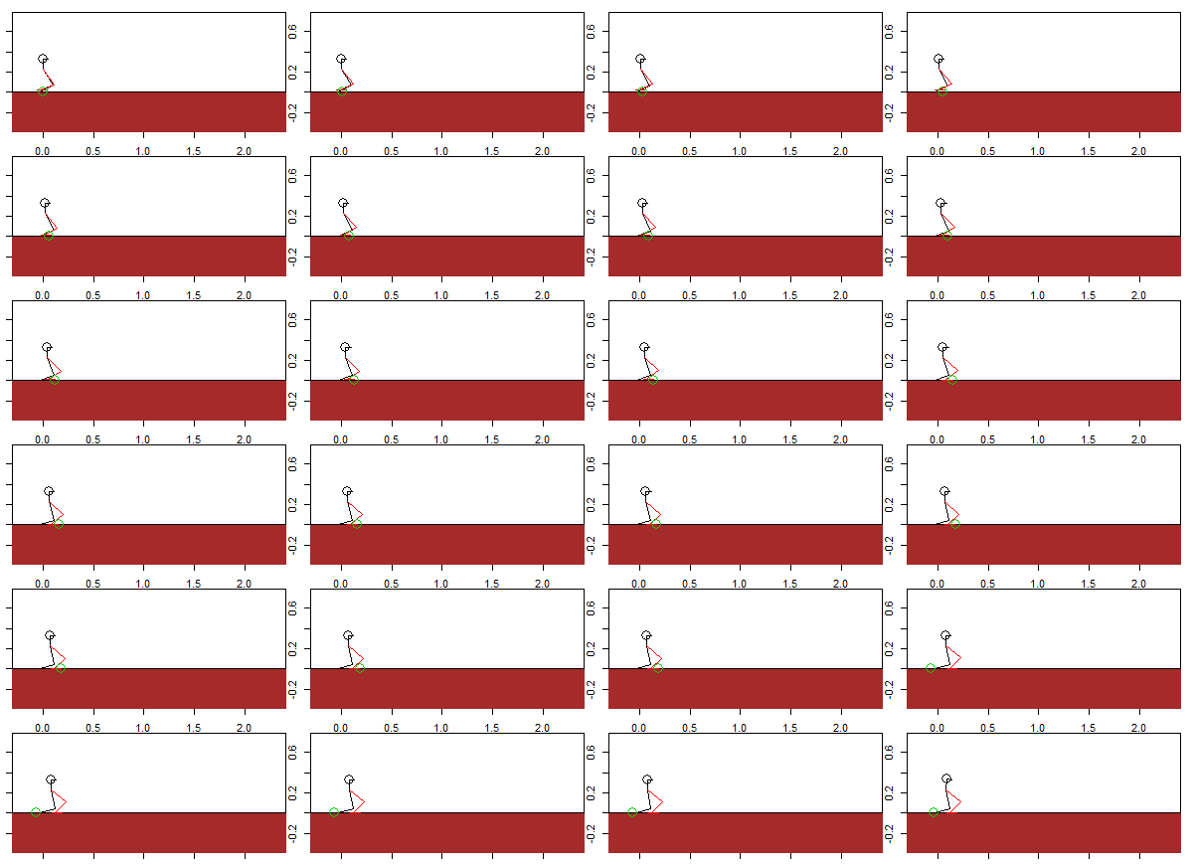
As such, the algorithm is repeated to draw 500 images.
Notes:
As such, the algorithm is repeated to draw 500 images.

Slide 44
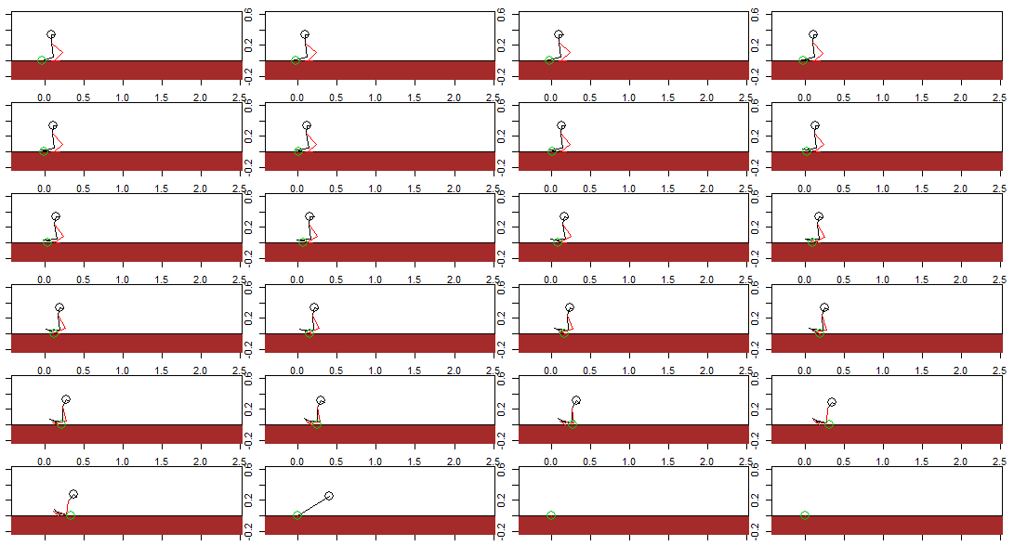
In this case, the robot falls at 41th iteration(t=0.41).
Fall down
& break
Notes:
In this case, the robot falls at 41th iteration.

Slide 45
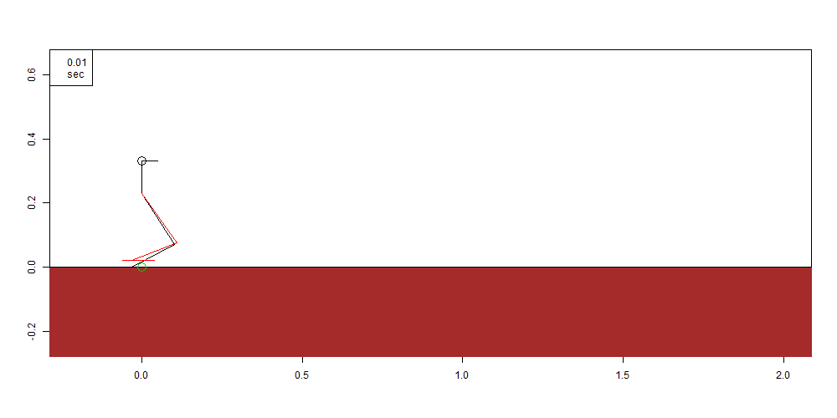
Merge the 500 images at 0.01 second intervals using "animation" package. If the robot falls, it keeps stopped in the applicable state.
T (gait cycle period) =0.9, s (gait width) =0.15, H(gait height)=0.02, h(pelvis height)=0.23, bias (gait-x bias) =-0.03
Fall down
Time
Notes:
Merge the 500 images at 0.01 second intervals using "animation" package. If the robot falls, it keeps stopped in the applicable state.
It is fall down time.

Slide 46
And in the case below, maximum x-value of center of mass(head) is 0.297
T (gait cycle period) =0.9, s (gait width) =0.15, H(gait height)=0.02, h(pelvis height)=0.23, bias (gait-x bias) =-0.03
Maximum x-value of center of mass
0.297
Notes:
And in the case below, maximum x-value of center of mass is 0.297
As such, physical simulation algorithm is constructed. Now, using Genetic Algorithm, one of the machine learning techniques, we want to find the farthest walking robot for five seconds.

Slide 47
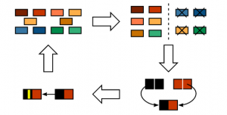
2-1) Genetic algorithm(GA)
Take 20 population samples
from range randomly
Select populations with a high y-value
Evaluation
Selection
Giving range of
each parameter
(or initial parameters population)
The more generations go on and on, the greater the y-value
Mutation
Cross over
Force a change of part
Mix the selected populations appropriately
Goal: Using GA, find parameters which make global maximum of x-value of the center of mass(find parameters that keep the robot farthest).
Notes:
So, what is genetic algorithm? It’s simple.
First of all, give range of each parameters.
Then, take 20 population samples from range randomly. Those population samples are 1st generation.
Then, select populations with a high y value in 1st generation.
Then, mix the selected populations appropriately and get new 20 populations.
Then Force a change of part of them. Then we get 2nd generation. The more generation go on and on, the greater the y-value
Our goal is using GA to find parameters which make global maximum of x-value of the center of mass.

Slide 48
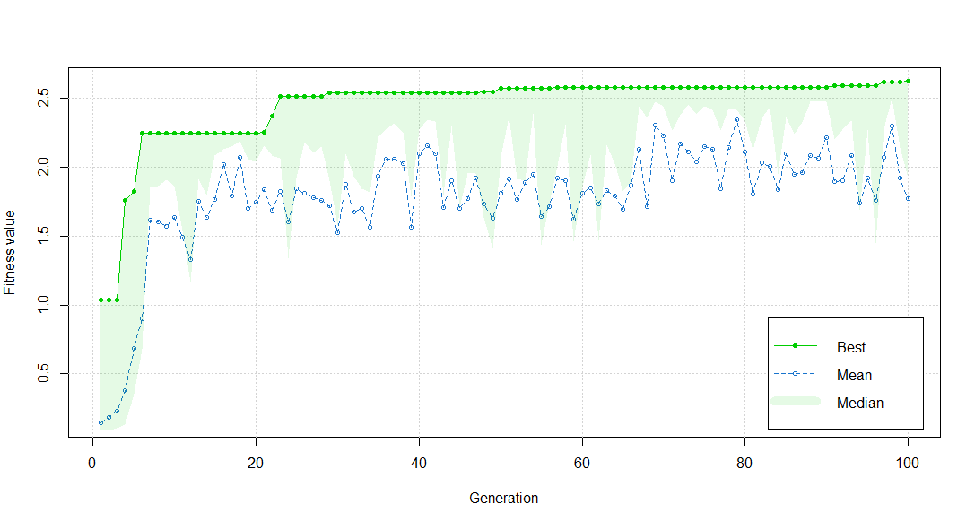
2-1) Applying GA: Evolution of fitness
Therefore, we applied the algorithm we made to GA. Fitness value is maximum center of mass x-value of robot in the generation. Green line is first place winner by each generation. The fitness value increases as the generation passes.
20 population 100 generations
First place winner of 1st generation’s fitness value is around 1
Notes:
Therefore, we applied the physical simulation algorithm we made to GA.

Slide 49
1st generation
T (gait cycle period) =1.118, s (gait width) =0.2, H(gait height)=0.06,
h(pelvis height)=0.22, bias (gait-x bias) =0.008
First place winner of 1st generation
Maximum x-value of center of mass : 1.038
Notes:
Let's race first place winners by generation. In the first generation, it falls in the middle.
Maximum x-value of center of mass is 1.038. (around here). Go to this point and fall back.

Slide 50
5th generation
T (gait cycle period) =1.126, s (gait width) =0.207, H(gait height)=0.055, h(pelvis height)=0.219, bias (gait-x bias) =-0.004
Maximum x-value
of center of mass
1st generation
First place winner of 5th generation
Maximum x-value of center of mass : 1.822
Notes:
In the fifth generation, it walks well. It easily exceeds the point where the first generation went.

Slide 51
20th generation
T (gait cycle period) =1.071, s (gait width) =0.237, H(gait height)=0.045,
h(pelvis height)=0.215, bias (gait-x bias) =-0.004
Maximum x-value
of center of mass
1st generation
5th generation
First place winner 20th generation
Maximum x-value of center of mass: 2.248
Notes:
In twentieth generation, it walks more farther than the previous generation.

Slide 52
100th generation
T (gait cycle period) =1.081, s (gait width) =0.277, H(gait height)=0.044,
h(pelvis height)=0.044, bias (gait-x bias) =-0.001
Maximum x-value
of center of mass
1st generation
5th generation
20th generation
First place winner by 100th generation
Maximum x-value of center of mass : 2.619
Notes:
In hundredth generation, it walks the farthest.

Slide 53
Let's race first place winners by generation. The new generation walks farther.
T (gait cycle period) =1.118, s (gait width) =0.2, H(gait height)=0.06,
h(pelvis height)=0.22, bias (gait-x bias) =0.008
T (gait cycle period) =1.071, s (gait width) =0.237, H(gait height)=0.045,
h(pelvis height)=0.215, bias (gait-x bias) =-0.004
1st generation
20th generation
T (gait cycle period) =1.081, s (gait width) =0.277, H(gait height)=0.044,
h(pelvis height)=0.044, bias (gait-x bias) =-0.001
T (gait cycle period) =1.126, s (gait width) =0.207, H(gait height)=0.055,
h(pelvis height)=0.219, bias (gait-x bias) =-0.004
5th generation
100th generation

Slide 54
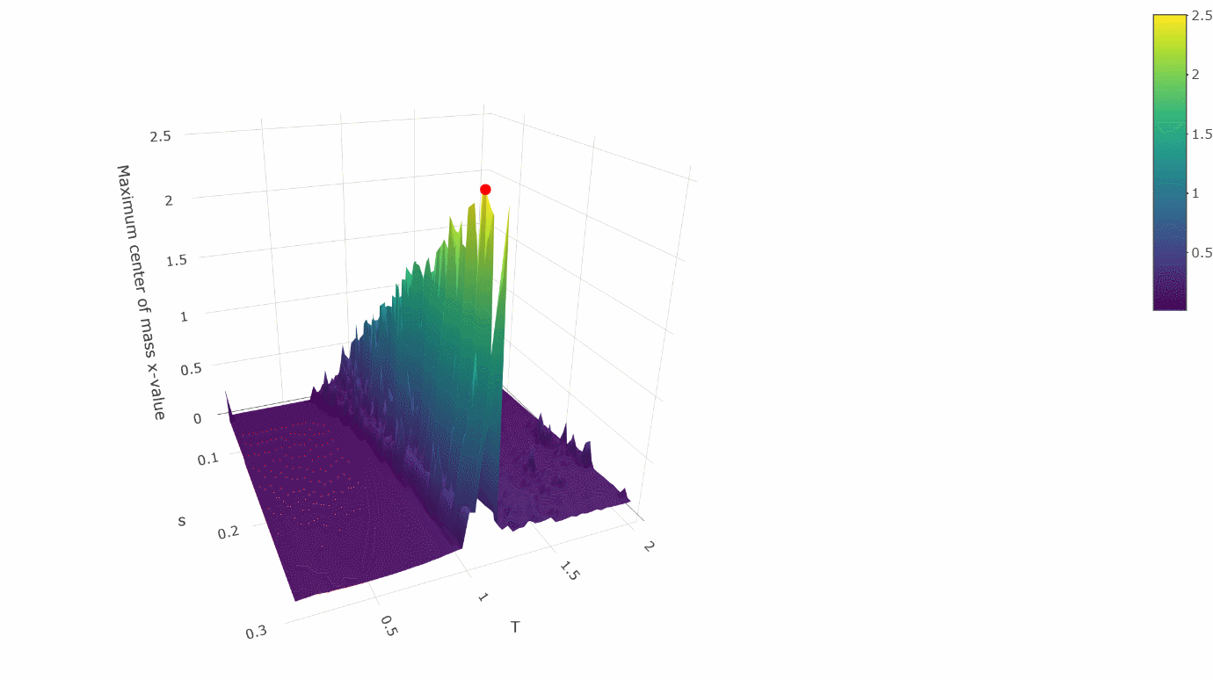
Maximum center of mass x-value according to T and s
We thought T (gait cycle period) and s (gait width) are important variables (parameters). So, we fixed other variables, and draw a three-dimensional graph with only those variables (T, s). The red point is the value of the variable optimized by GA. It looks like GA found the global maximum.
53

Slide 55
Conclusion
Though it was only for our robot, but we created a physical simulation space.
We conducted machine learning (GA) in a physical simulation environment.
Walking varies according to parameters, and we found parameters that make the fastest and best walk.
We were able to watch the evolution process using R.

Slide 56
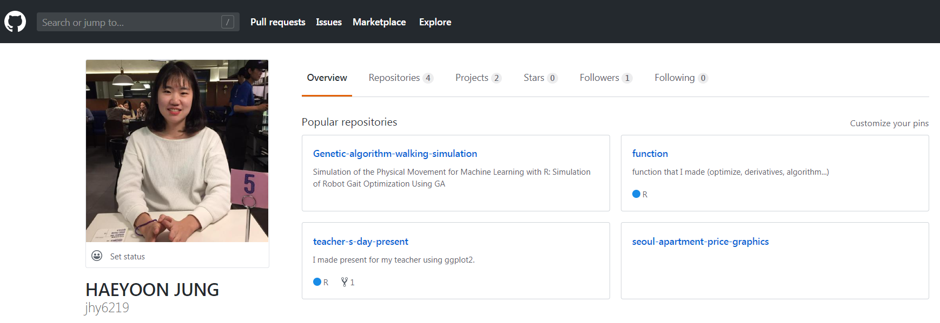
If you want to know the R code, please come to my github.
https://github.com/jhy6219

